Slide 2
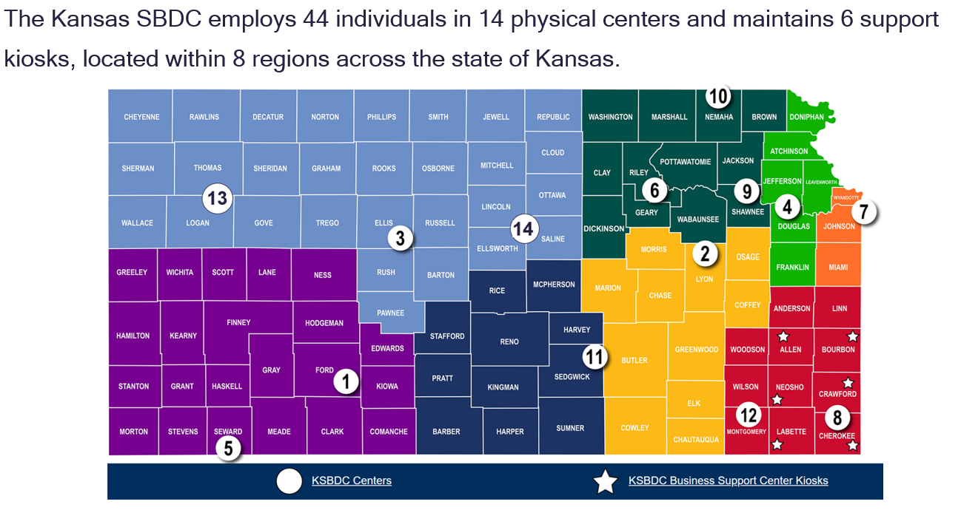
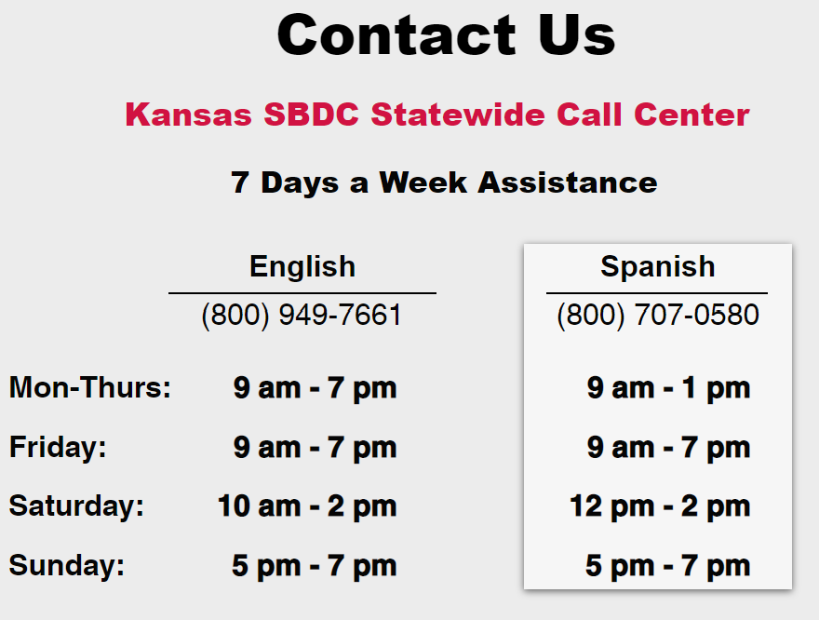

Slide 3
1x1 Consulting and Training
on-line training and on-demand video linrary
What We Provide
Business Consulting
Accounting
Budget Planning
Buy/Sell a Business
Cash Flow Management
Customer Relations
eCommerce
Franchising
Government Contracting
International Trade
Legal Issues
Managing a Business
Human Resources & Organizational Development
Start-Up Assistance
Tax Planning
Technology/Computers
Market Research
Search Engine Optimization (SEO) Analysis
Export Strategy
Transition Planning
Business Plan Development Financial Management
Marketing Strategy
In-Person Training Workshops
Live Online Training
On-Demand Online Training
Technology Roadmapping
Investor Readiness
Commercialization Strategy
Business Accelerator Fund
Emerging Technology Fund
SBIR/STTR Proposal Review
Cybersecurity
Loan Package Development
Notes:
SBDCs are here to help entrepreneurs start and existing businesses to grow.
Given the breadth of who we serve, we need to be generalists, and our list of services is large.
At our core we Listen- Tailor an approach – and Guide businesses to successful outcome, with everything from market research, strategy, capital formation and exit planning.
We also realize that specialty services may be need for unique sectors of client base, like growth, international trade and tech commercialization, and based on trends we may further specialize into new sectors, even sectors like “managing your business during a pandemic”
JD Collins
State Director
Michigan SBDC

Slide 4
What We Provide
Kansas Specialties
Technology Commercialization
Encountering Innovation
NASA Prime Matchmaking
Lunch and Learns
FAST Grant Activities
Business Valuation/Transition
Exit Services
Valuation Improvement
Certified Valuation Analysts
Human Resources Assistance
SHRM Certified
Export Trade
Capital Access Center
Loan assistance
Call Center
7 days a week
Extended Hours
Cybersecurity
Notes:
JD Collins State Director Michigan SBDC

Slide 5
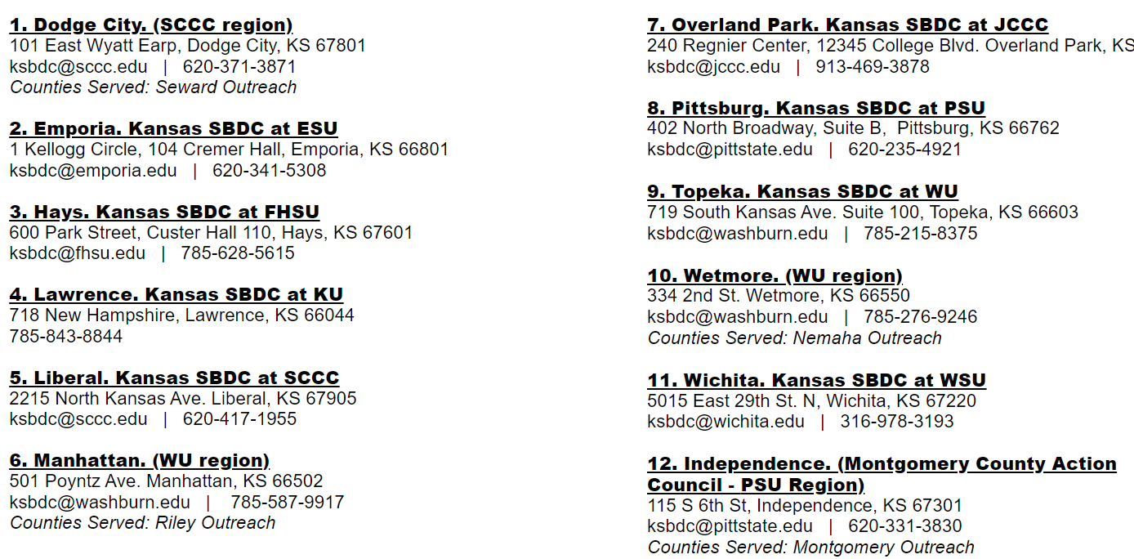
What We Provide
Not sure if KSBDC can help?
Call or contact anyway…
info@ksbdc.net; https://www.facebook.com/sbdckansas/; https://twitter.com/sbdckansas; https://www.linkedin.com/company/sbdckansas/mycompany/
Notes:
JD Collins State Director Michigan SBDC

