Slide 1
Partnering with Communities to
Build Child Care Capacity
CDBG Webinar
October 20, 2022

Slide 2
Notes:
Our approach is a four-phase approach. That supports communities through communities where they are at.

Slide 3
Pre-Planning/Support
Provide tactical, early-stage support to communities to determine level of readiness.
Customize support to community needs but could include:
Support for general coalition-building,
Guidance on economic impact
Support for completion of community-level needs assessments.
Project funded by Department for Children and Families
Notes:
Identification of and outreach to engage key stakeholders
Support to communities for identifying the logistics of early-phase convening, including: establishment of location, connection options, meeting frequency, and other details
Support to communities for establishment of a coalition governance structure that outlines clear decision-making procedures or protocols and a system of record keeping to facilitate the coalition's progress on implementing short- and long-term goals
Supports include assessments of community capacity at the coalition level and using existing measures and strategies to inform shared decision-making
Providing reliable, valid and comprehensive guidance to would-be early care and education providers on both the true start-up costs for the different modes of early care and education delivery, and the true costs of maintaining successful child care operations.

Slide 4
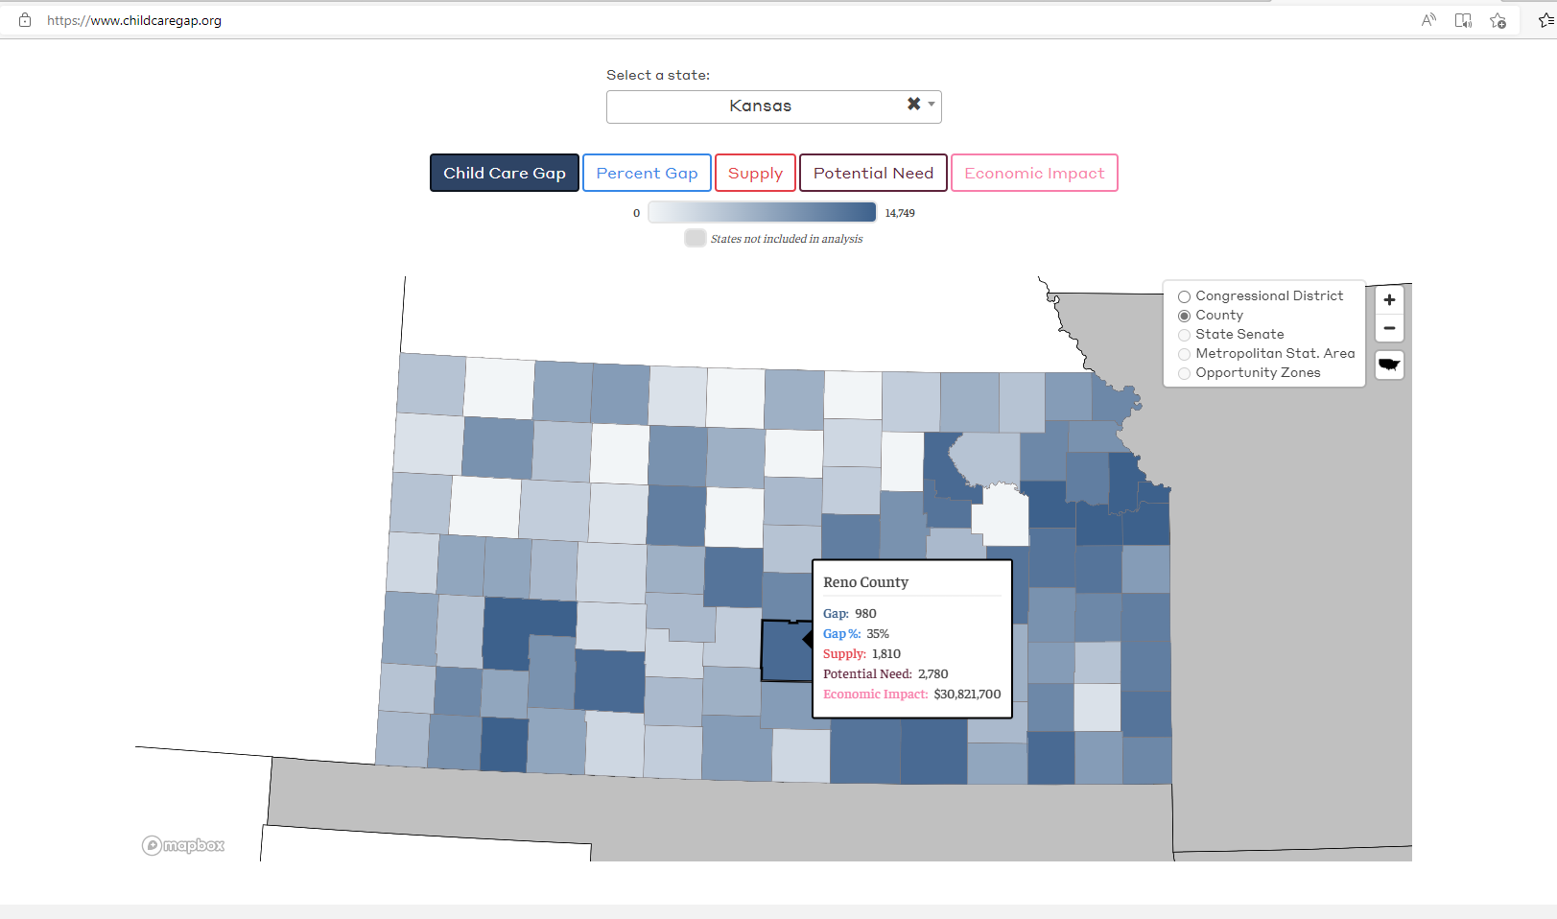
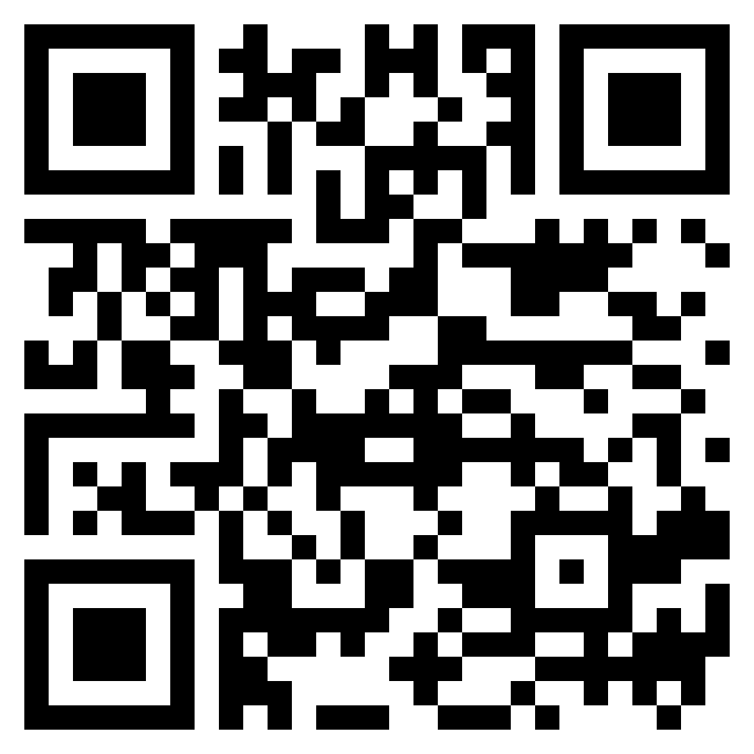
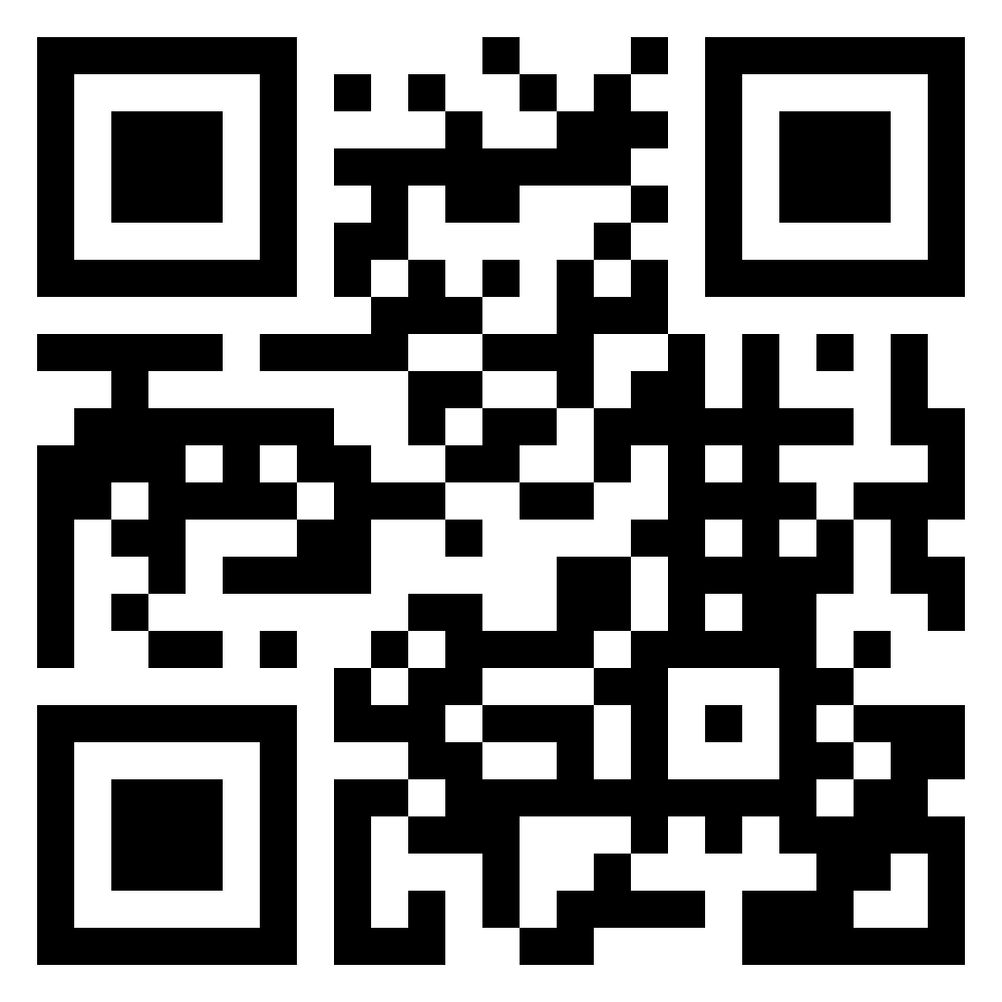
Resources for Communities
Community data
Trend data
Child care gap
Kansas data
Economic Impact
Annual Supply Demand
County data for under age Three
Trend data
ks.childcareaware.org/communities
Child Care Gaps Assessment
Project funded by Department for Children and Families
Notes:
Community data resources: Point in Time, Kansas data available

Slide 5
Communities in Action Workshop
Workshops are attended by community "teams“, determined by each community
Provides customized opportunities for community teams to learn from early childhood experts and other content experts from across Kansas' early childhood system, receive customized child care supply/demand data, and delve into identification and development of short- and long-term goals during structured planning time with an expert community coach.
Project funded by Department for Children and Families
Notes:
A typical workshop agenda includes presentations on the following topics:
the child care landscape and economic impact
child care licensing considerations and the importance of licensed, quality early care and education "real life" perspectives of current licensed child care providers
An overview of the full suite of services and resources available via Kansas' early childhood system workforce development strategies, including professional development and career pathways for early care and education professionals
structured team planning time that focuses on short- and long-term goal setting.

Slide 6
Funding
Initial Child Care Coalition Building Grant
Communities may request up to $2,000 to support initial child care coalition-building activities.
Implementing Child Care Capacity-Building Plans
Child care coalitions may request up to $45,000 to implement plans to address access to affordable, high-quality child care.
Project funded by Department for Children and Families
Notes:
Three step process:
1. Complete an Inquiry Form: To get started, tell us about your community’s efforts so we can connect you with available technical assistance & funding opportunities.
2. Participate in a consultation: After we receive your completed inquiry form, one of our Community Consultants will contact you to discuss eligibility.
3. Apply for funding based on eligibility: After your consultation, we will help you determine the next steps, and walk you through the application process.

Slide 7
GRANT INFORMATION
Funding resources are provided for communities interested in increasing efforts to expand child care capacity.
Notes:
Funding resources are provided for communities interested in increasing efforts to expand child care capacity. This funding is available to any community that has successfully completed a Communities in Action Workshop or are at a level of readiness with short- and long-term goals/action plan. Communities that level should have a strong child care workgroup (coalition/taskforce) that have a process in place for the coalition/taskforce to make decisions. This allows for child care coalition/taskforce to continually move forward in their child care building plans in a community lead approach.

Slide 8
Follow Up/Continued Support
Ongoing support is tailored to the readiness, pace, and scale of each community to support successful execution of the goals/action plan developed during the Communities in Action workshop.
While the experience is customized for each community, our follow-up support for communities will focus on ongoing support for coalition-building and strategic implementation of community goals/plans.
Project funded by Department for Children and Families
Notes:
Child Care Aware of Kansas and our partners provide tailored support to communities in identifying and implementing the key activities necessary to maintain or expand a local child care coalition. This may include
Expanded outreach to stakeholders,
Regular attendance at community coalition meetings to provide information, resources, and connection to other content experts (i.e. child care licensing) as progress on community plans continues, and
Support for refining governance structures as the coalition matures.
Active implementation of short-term strategies, goals, and action steps
Monitoring of identified outcomes and performance measures with modifications to short-term goals as appropriate
Expanding short-term strategies in response to fluctuations within a community's child care landscape (i.e. a child care program closes)
Strategic support to shift from short-term goals to long-term strategies and action steps. This may include identification of funding and other resources to support implementation of community action plans
Engage in a review of current goals and support the community coalition in identifying additional goals and strategies to continue expanding access to high quality early care and education

Slide 9
Resources
Family Friendly Workplace
Continued community financial resources
Child Care Budgeting Tool
Assistance with barriers

Slide 10
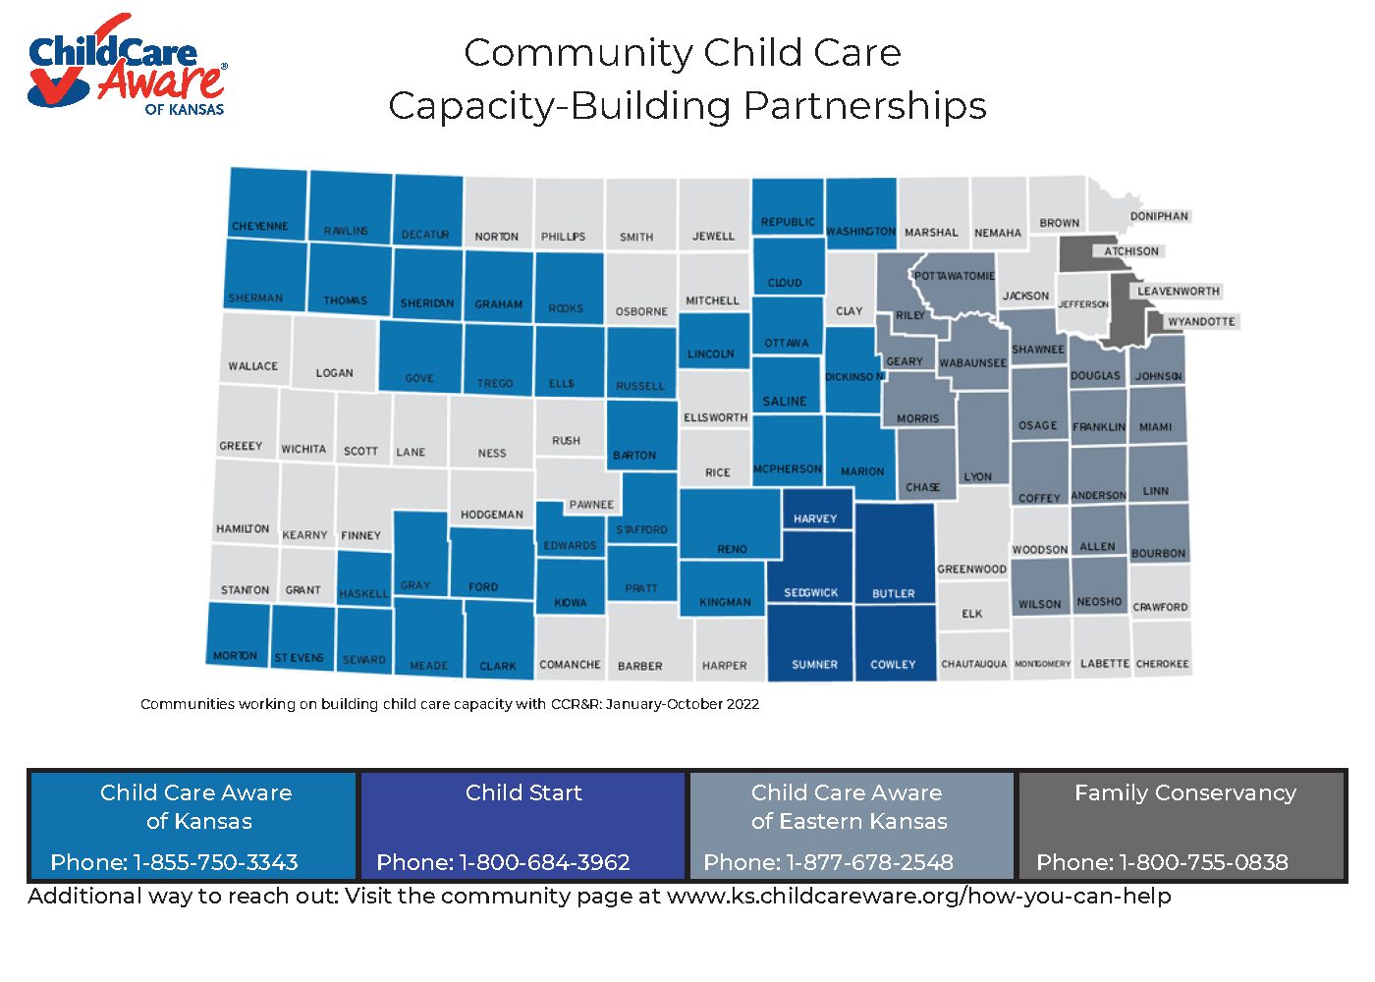
Project funded by Department for Children and Families
Notes:
CCAKS with our CCR&R partners are working with communities across the state. We have completed 14 Communities in Action with 22 communities.

Slide 11
For Community Support Contact:
communitysupport@ks.childcareaware.org
Tanya Koehn: Director of Families and Communities
tanya.koehn@ks.childcareaware.org

