Slide 1

Opening a Child Care Facility
Understanding the Licensing Process

Slide 2
Purpose of KS Child Care Licensing
Protect the health, safety, and welfare of children receiving care away from their homes and parents/guardians
KDHE licenses and regulates/monitors facilities and care
State laws (K.S.A. 65-501 et. seq.) define the scope and authority
Administrative regulations further detail facility requirements
Families can choose from several other child care settings, legally exempt from licensing; choices are driven by the needs of children and families.

Slide 3
Step 1:
Determine what license/facility type fits your need?
Licensed Day Care Home
Group Day Care Home
Preschool
Child Care Center
School Age (SA) Program
SA Drop-In Program
Who do you wish to serve?
Hours of operation?
Staffing needs?

Slide 4

Step 2: Attend Orientation
Applicant attends an orientation provided by the local child care licensing surveyor.
  This is required prior to submitting an application.
  The surveyor will provide a guided experience over regulation requirements for license type, application requirements and the survey process.
  Local County Contacts: https://www.kdhe.ks.gov/DocumentCenter/View/2126/Find-my-Surveyor-PDF?bidId=

Slide 5
Step 3: Partner Requirements
NOTE: Applicant’s applying for a center-based license may request a consultation to discuss any concerns with the setting and obtaining compliance with space, fire/exiting, plumbing, and other essential requirements affected by structural issues.
Site Approval by KDHE is also required for commercial settings.
Applicant contacts city, and/or county to inquire about building codes, zoning and other applicable ordinances/processes required to operate a child care facility. Different code/rules apply to center-based facilities vs. home-based and commercial vs. non-commercial buildings.
Applicant contacts the local and/or State Fire Marshal’s (KSFM) office to discuss fire life safety codes and rules for the local jurisdiction (if applicable) or state fire requirements based on the type of license and setting/building. The local licensing surveyor can advise on whether or not local fire inspects, otherwise inspection and approval must be obtained by KSFM. NOTE: Fire approval must be granted for KDHE to issue a temporary permit/license.

Slide 6


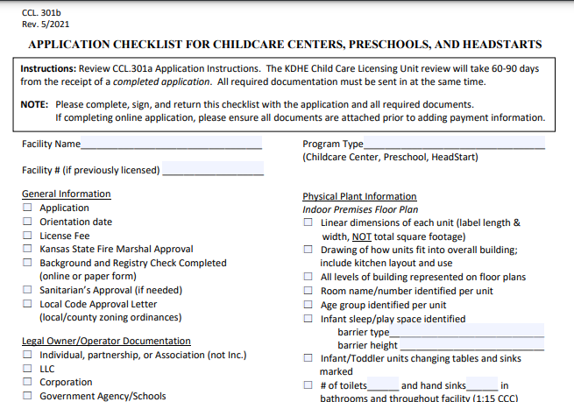
Step 4: Applicant submits an application to KDHE
Online or paper
https://www.kdhe.ks.gov/286/Child-Care-Licensing-Forms-Applications
All application requirements must be provided along with all background check information.

Slide 7
Step 5: KDHE processes application & background checks
Application Process
KDHE cannot process an incomplete application. Applicants receive a letter with detailed information if an application is not complete.
Once the application is complete, KDHE requests the initial inspection to be conducted by the local licensing surveyor.
Background Checks
Background checks are submitted by KDHE to DCF (abuse and neglect registry) and KBI (name-based criminal and sex offender registry; fingerprints if applicable based on role and federal rules) for applicant/owner and any residents and staff.
Out of state checks are required for any person that lived in another state in the last 5 years.
Applicants and any person that will work unsupervised in the facility must complete fingerprinting at an authorized local site. Ink prints are mailed to KDHE by the person and then sent to KBI via interoffice. Digital prints (only available in select locations) are sent directly to KBI. Results are sent back to KDHE from KBI via electronic queue (KChat).

Slide 8
Step 6: The Initial Survey
Applicant schedules appointment for the initial inspection with the local surveyor.
Local surveyor conducts initial inspection. A compliance check may be conducted to verify any violations were corrected,
The survey is routed to KDHE for processing.
Licensing determination is made: A TP is issued for center-based programs if the facility is in substantial compliance.
NOTE: Fire approval must be complete before KDHE can issue a temporary permit.

Slide 9
Questions?
Melissa Schoenberger
Assistant Director
Child Care Licensing
785-207-0623
Melissa.Schoenberger@ks.gov
Jennifer Manuel
District Specialist
Child Care Licensing
316-337-6033
Jennifer.Manuel@ks.gov

