Slide 1
Community Service Tax Credit (CSP) 2023-2024 Informational Webinar

Slide 2
Agenda
Introduction to CSP
What are Tax Credits?
How Do Tax Credits Work?
Application Requirements
Website Walkthrough

Slide 3
Introduction to CSP
The Community Service Tax Credit Program (CSP) provides an opportunity for private, non-profit organizations and public healthcare entities to improve their ability to undertake major capital
campaigns.
Qualifying Projects
Under the Kansas Community Service Tax Credit Program each proposal shall address one of the
following areas in order to qualify:
• Community Service, including Childcare
• Non-governmental Crime Prevention
• Youth Apprenticeship and Youth Technical Training
• Healthcare Services

Slide 4
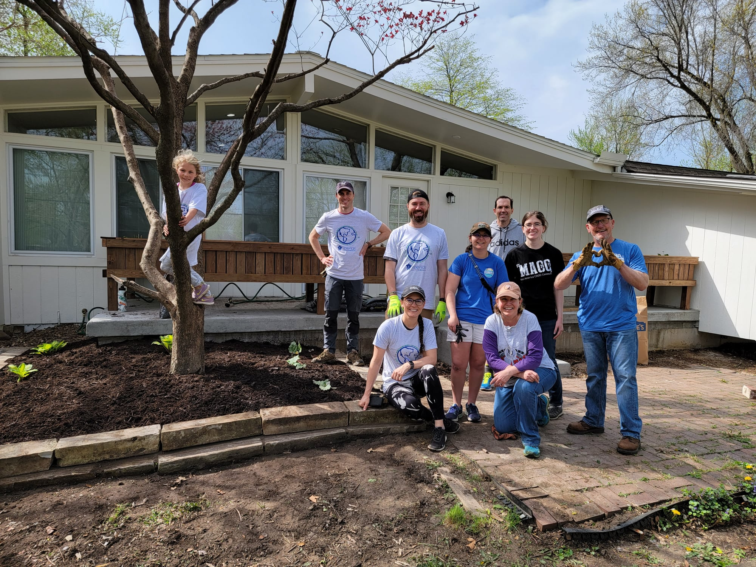
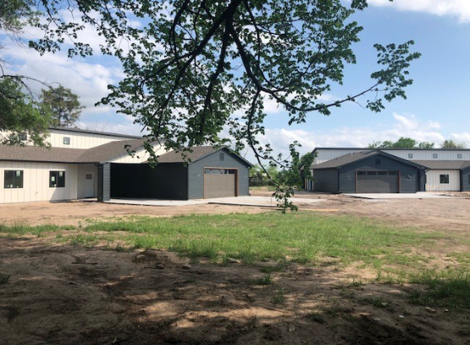
Donations have helped fund…
Housing projects
Housing for Individuals with Intellectual and Developmental Disabilities, Gardner
The Wren Home for at-risk girls, Wichita

Slide 5
Donations have helped fund…
Community improvements
Railroad Quiet Zone, Belle Plaine
Redler Institute of Culinary Arts, El Dorado

Slide 6
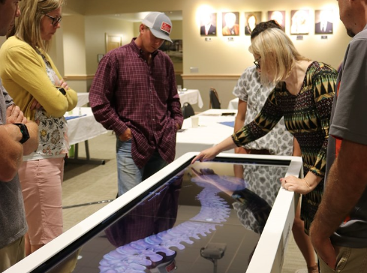
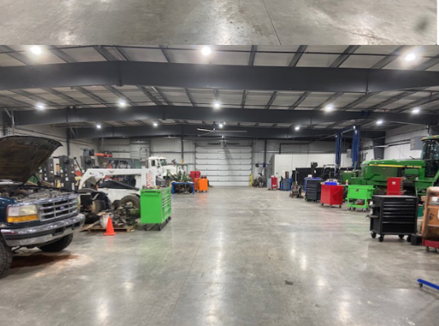
Donations have helped fund…
University expansions, renovations and equipment
Anatomage Tables,
Garden City Comm. College
Diesel Technology Facility,
Highland Comm. College, Atchison

Slide 7
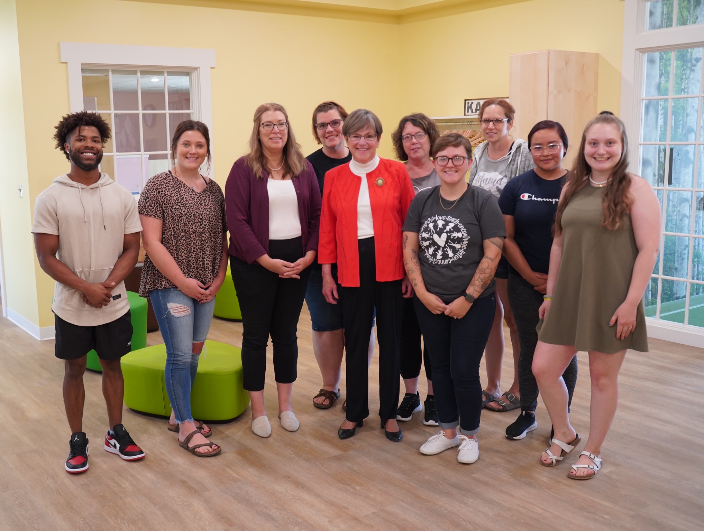
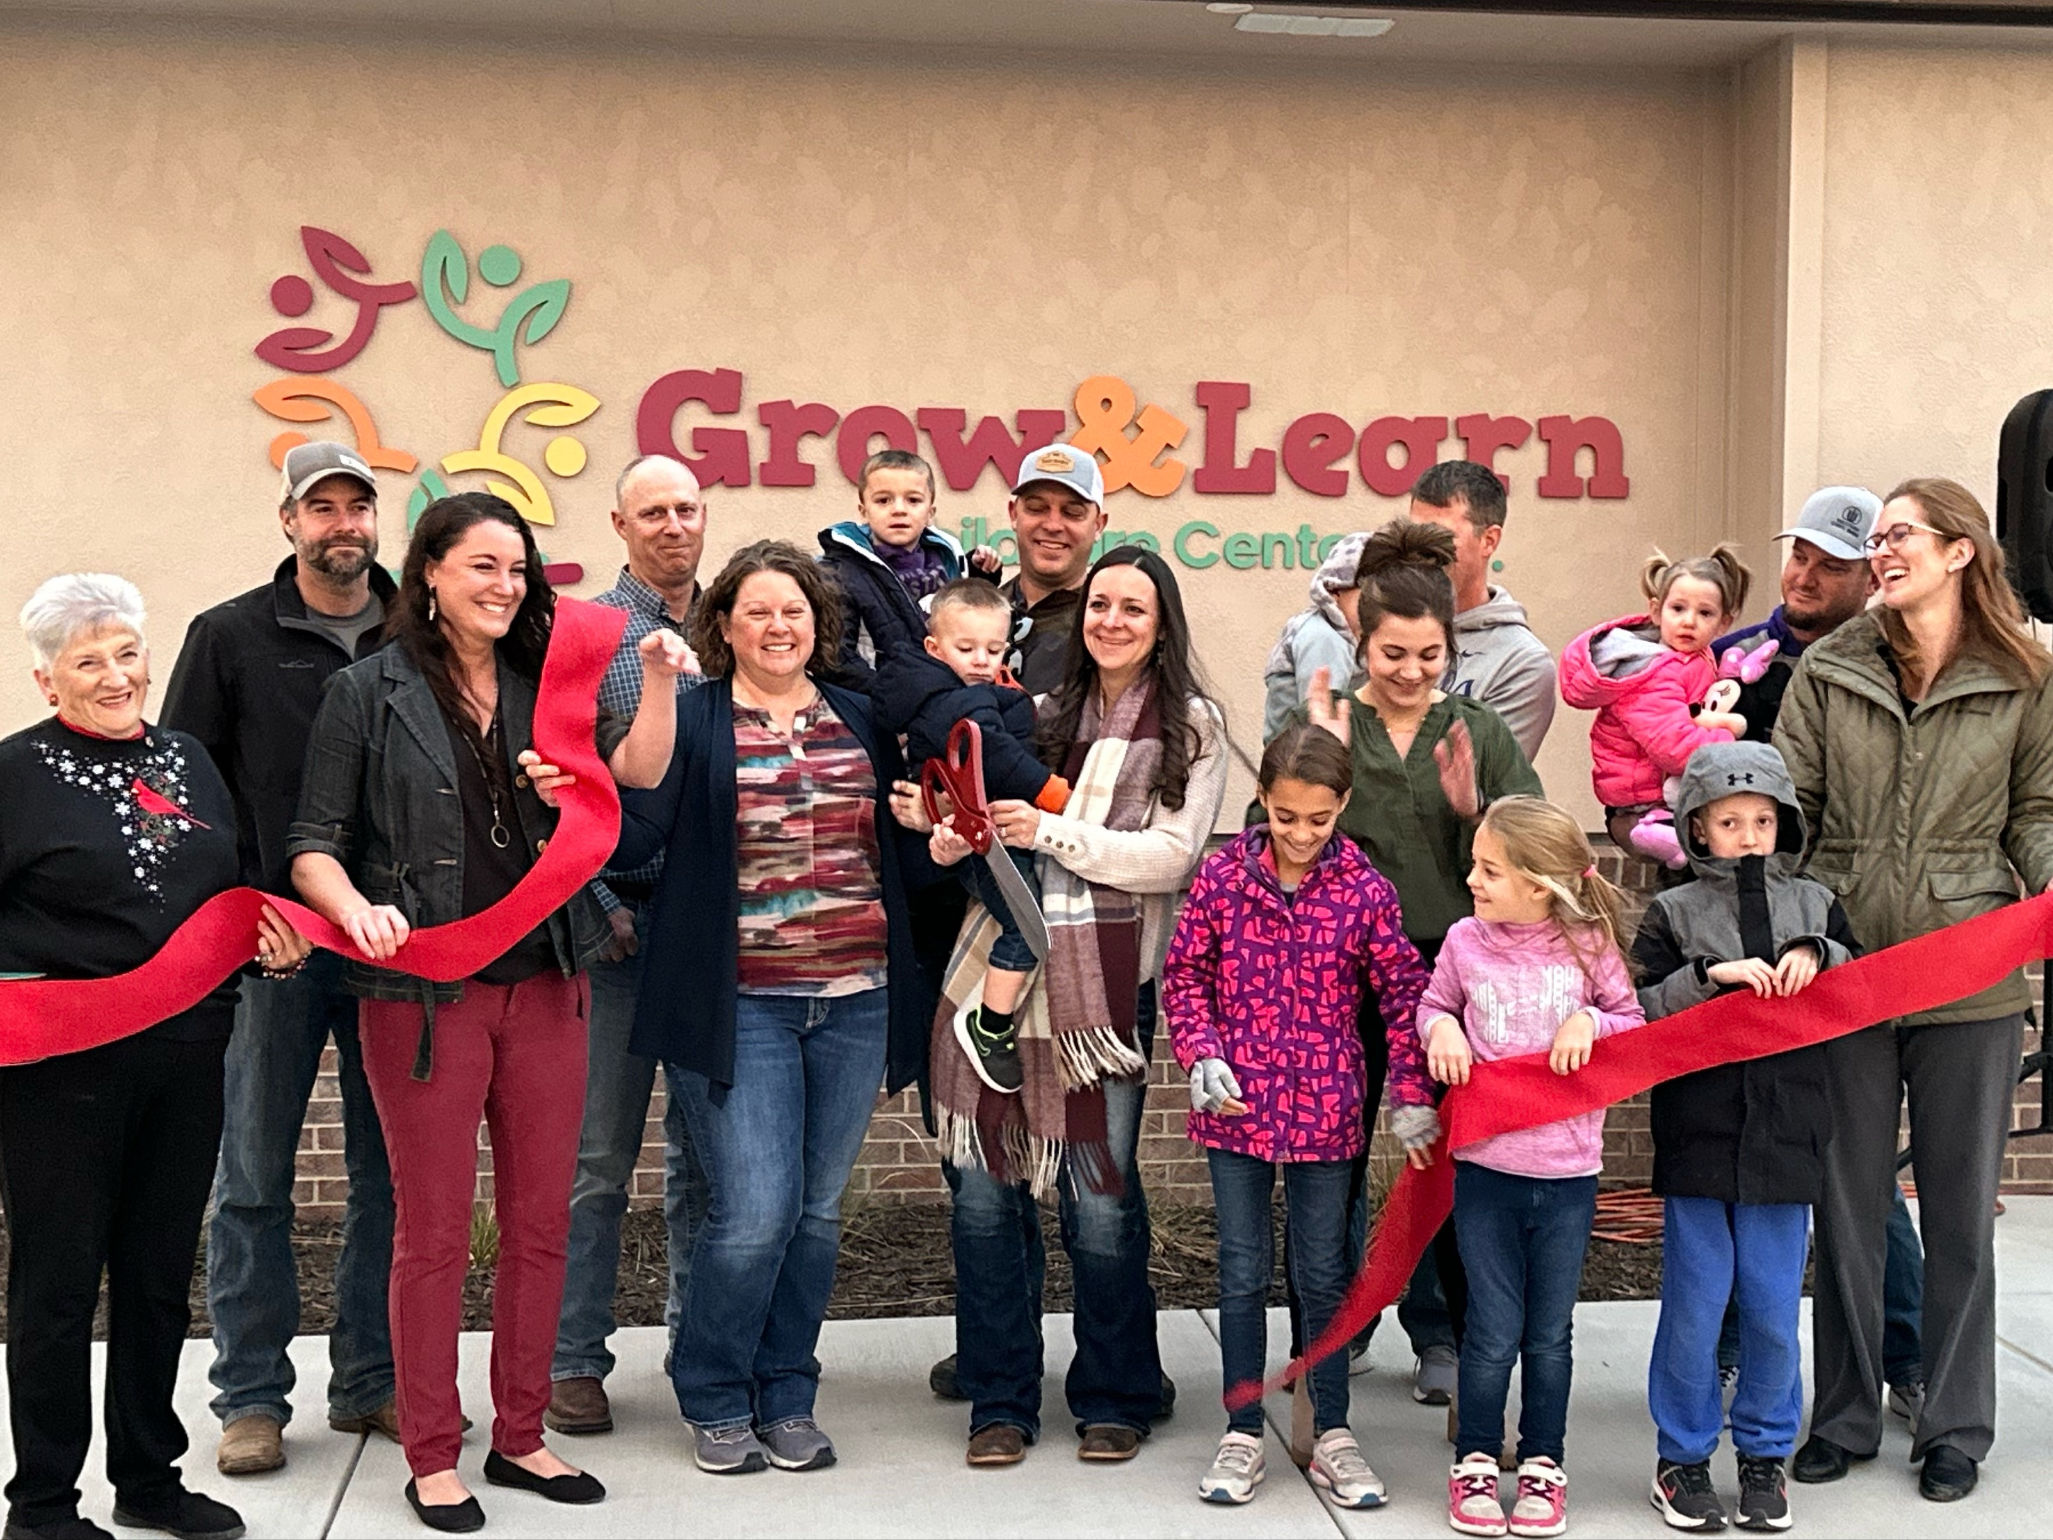
Donations have helped fund…
Non-profit childcare facilities
Sprout House Learning Center, Lindsborg
Grow & Learn Childcare Center Inc., Leoti

Slide 8
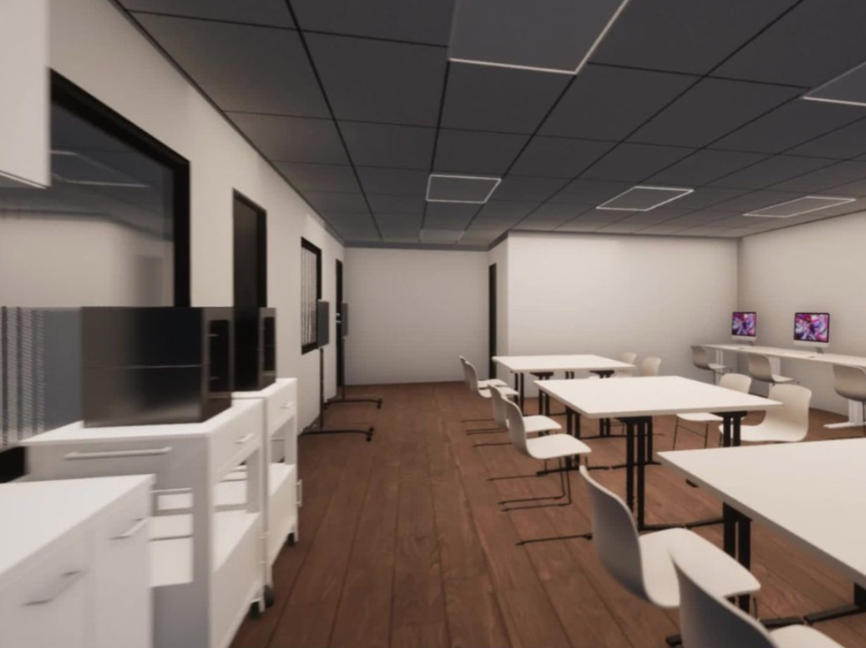
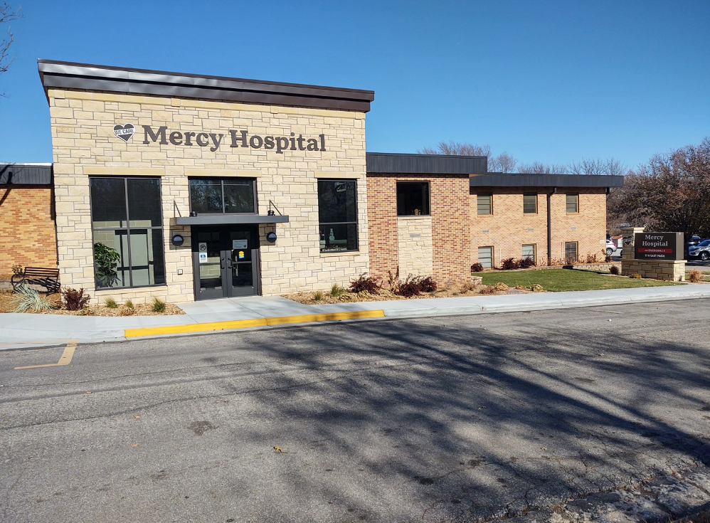
Donations have helped fund…
Arts-focused projects such as centers and theaters
Health clinics, mental health facilities hospital expansions, renovations, and equipment
Nursing homes and assisted living facilities
Wellness and fitness projects
Innovation Lab, Emporia Arts Council
Mercy Hospital, Moundridge

Slide 9
Program Timeline
The application opens March 1, 2023 to April 30, 2023
The application will close at 11:59pm
Technical assistance stops at 4:00pm
$250 Application Fee
Awarded projects will be notified no later than July 1, 2023
Tax Credits will be “active” July 1, 2023 to December 31, 2024
Final Project reports will be due by June 30, 2025

Slide 10
Funding
Available Funds
$4.1 million is available
$1 million has been earmarked for non-profit childcare facilities
Maximum Award
$200,000 in tax credits

Slide 11
What are Tax Credits?
A direct reduction from the final tax obligation in the awarding jurisdiction (federal, state, local)
Not the same as a deduction
Better than a deduction
Can be combined with a deduction in some circumstances (State Credit + Federal Deduction)
Refundable: If the tax credit is greater than the tax credit liability, the tax filer receives a refund.
Transferrable: The tax credit can be transferred from a donor not subject to KS income tax to an entity that is subject. Must be for the full amount. (Not refundable)

Slide 12
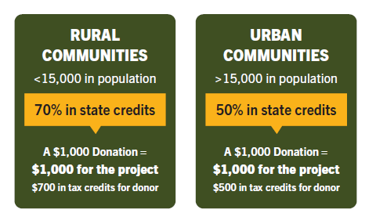
How Do Tax Credits Work?
Through CSP, the state authorizes selected non-profit organizations to offer tax credits to donors for the benefit of approved projects. Applicants may request up to $200,000 in tax credits. Projects should be new or one-time in nature and create lasting value for the
non-profit organization.
Businesses and individuals subject to Kansas income tax are eligible to receive a tax credit through this program. Donations must be $250 or greater and the payment
should come directly from the business or the individual.

Slide 13
CSP Project Budget Example:
Tax Credit Allocation at 70% (rural)
$150,000
Will generate $214,285 in donations
Tax Credit Allocation at 50% (urban)
$150,000
Will generate $300,000 in donations

Slide 14
Application Requirements
Narrative Sections:
Organization Introduction: 250 word limit
Project Need: 300 word limit
Project Summary: 300 word limit
Project Administration: 250 word limit
Project Goals and Timeline: 350 word limit
Organization Funding Capacity: 350 word limit
Project Funding Strategy: 350 word limit
Budget Justification: 200 word limit
Refer to page 9 in the CSP Guidelines for more details.

Slide 15
Application Requirements
Attachments:
Articles of Incorporation
Bylaws of the organization
IRS tax-exempt status
A current “letter of good standing” from the Kansas Secretary of State
A current list of the board of directors
Pledge letters of financial support for the project
Other letters showing support and
Financial audit of the organization
This is NOT an exhaustive list. Refer to page 10 in the CSP Guidelines for more details.

Slide 16
Questions?

Slide 17
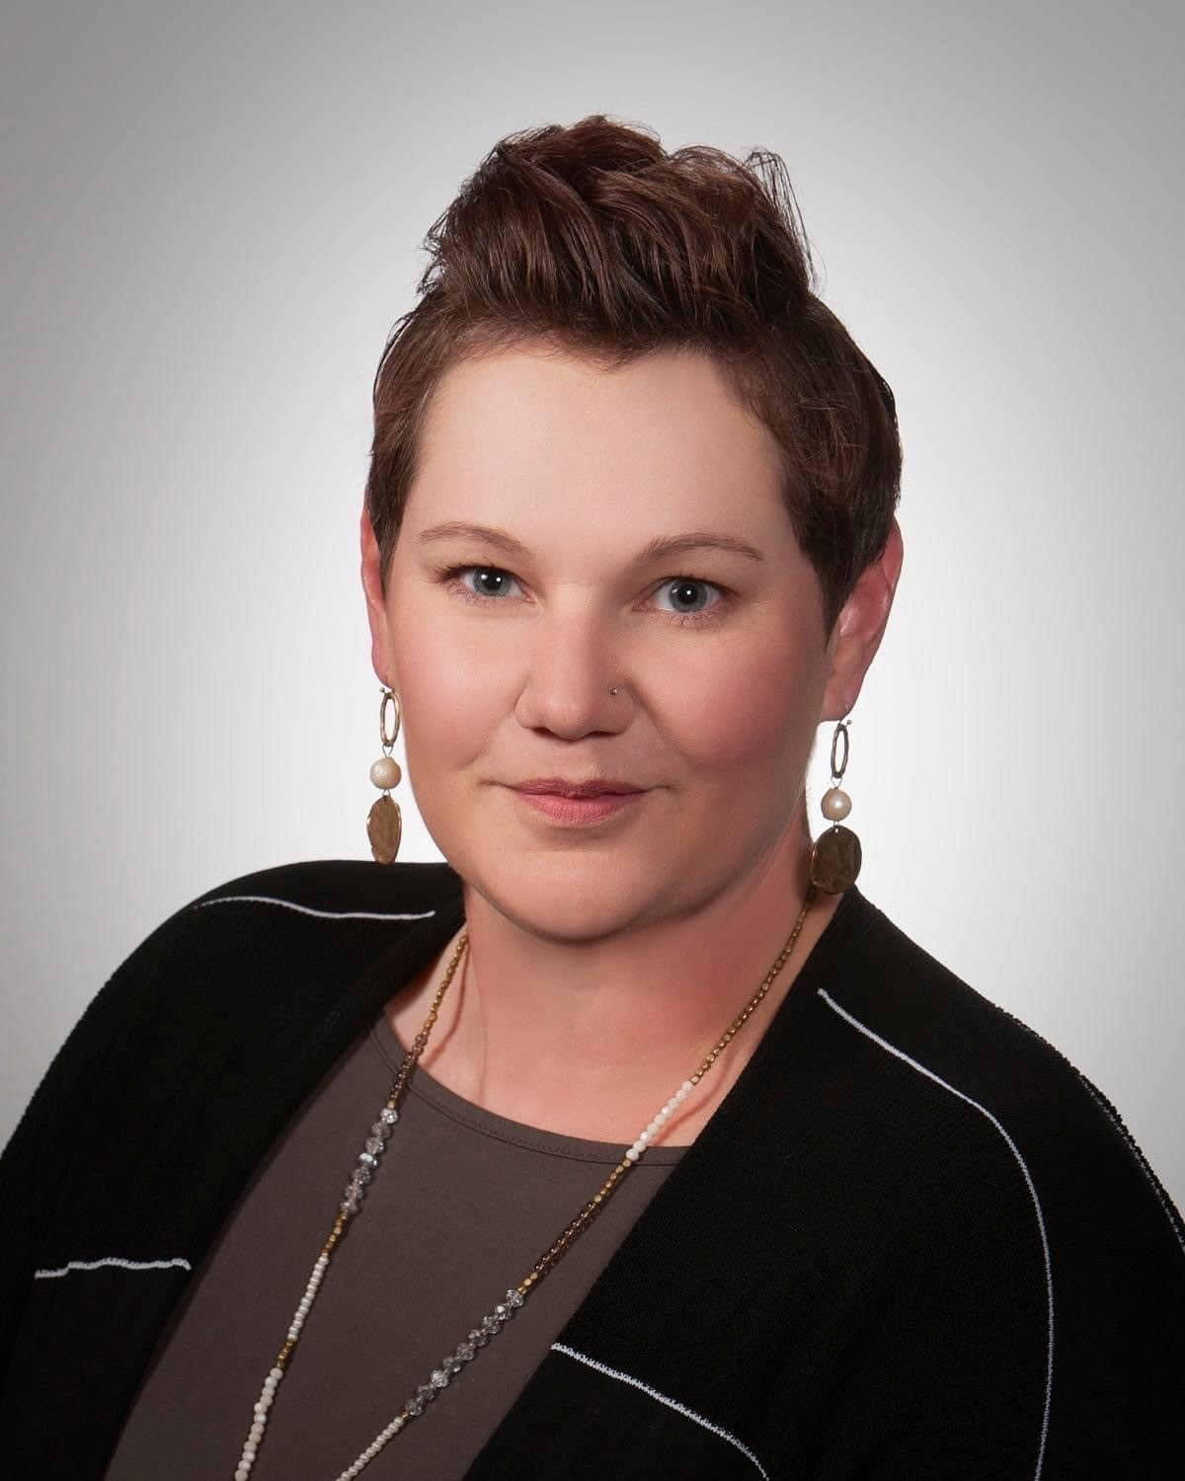
Contact
Sara Bloom
Community Development Specialist
CSP and IDA Program Coordinator
Kansas Department of Commerce
1000 S.W. Jackson Street, Suite 100
Topeka, Kansas 66612-1354
Phone: (785) 506.9278
e-mail: Sara.Bloom@ks.gov

