Slide 1
Community Service Tax Credit (CSP) 2024-2025 Informational Webinar

Slide 2
Agenda
Introduction to CSP
What are Tax Credits?
How Do Tax Credits Work?
What Happens After the Award?
Application Requirements
Rating Process
Website Walkthrough

Slide 3
Introduction to CSP
The Community Service Tax Credit Program (CSP) provides an opportunity for private, non-profit organizations and public healthcare entities to improve their ability to undertake major capital
campaigns.
Qualifying Projects
Under the Kansas Community Service Tax Credit Program each proposal shall address one of the
following areas in order to qualify:
• Community Service, including Childcare
• Non-governmental Crime Prevention
• Youth Apprenticeship and Youth Technical Training
• Healthcare Services

Slide 4
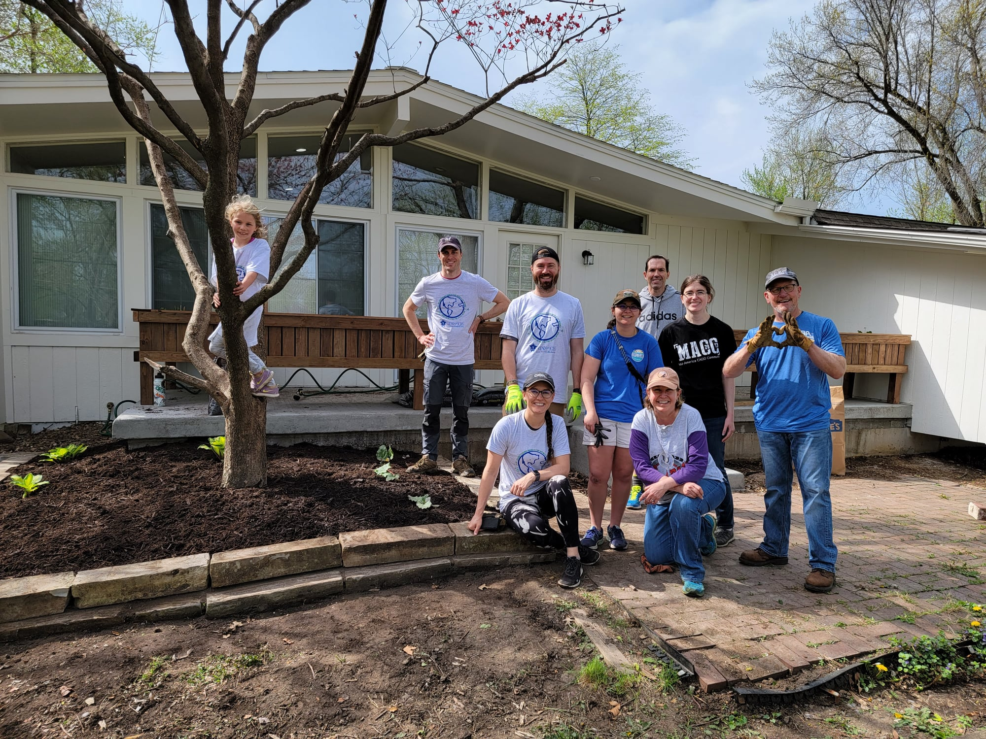
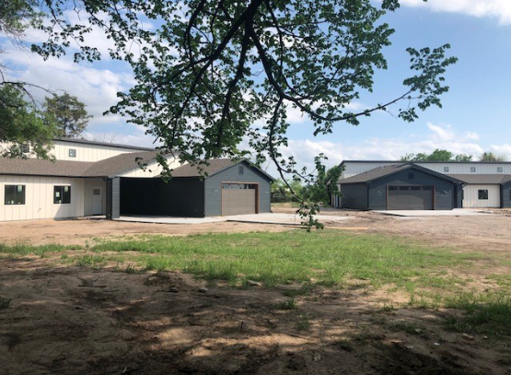
Donations have helped fund…
Housing projects
Housing for Individuals with Intellectual and Developmental Disabilities, Gardner
The Wren Home for at-risk girls, Wichita

Slide 5
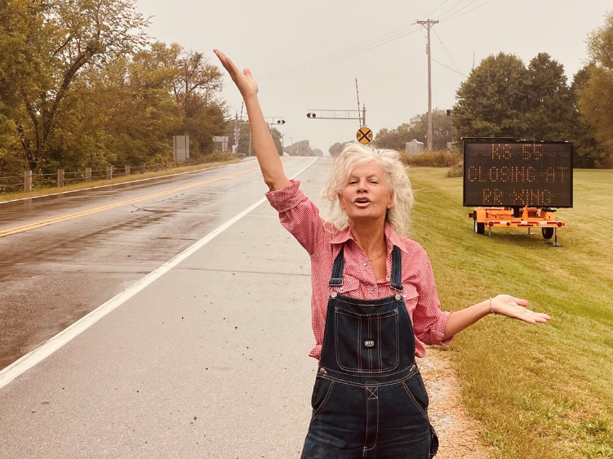
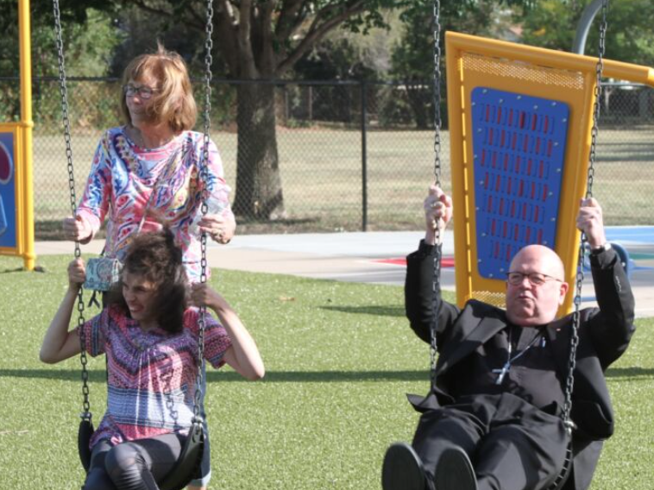
Donations have helped fund…
Community improvements
Railroad Quiet Zone, Belle Plaine
Catholic Charities Adult Recreation Campus, Wichita

Slide 6
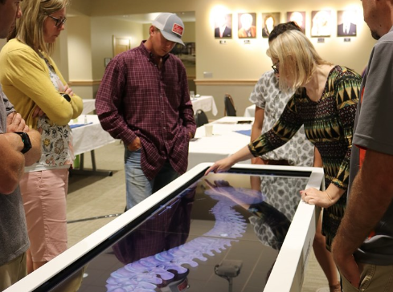
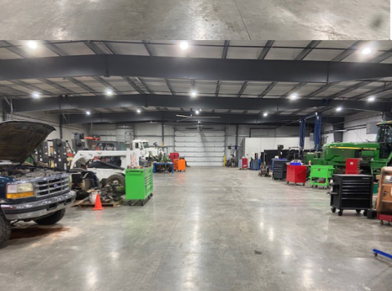
Donations have helped fund…
University expansions, renovations and equipment
Anatomage Tables,
Garden City Comm. College
Diesel Technology Facility,
Highland Comm. College, Atchison

Slide 7
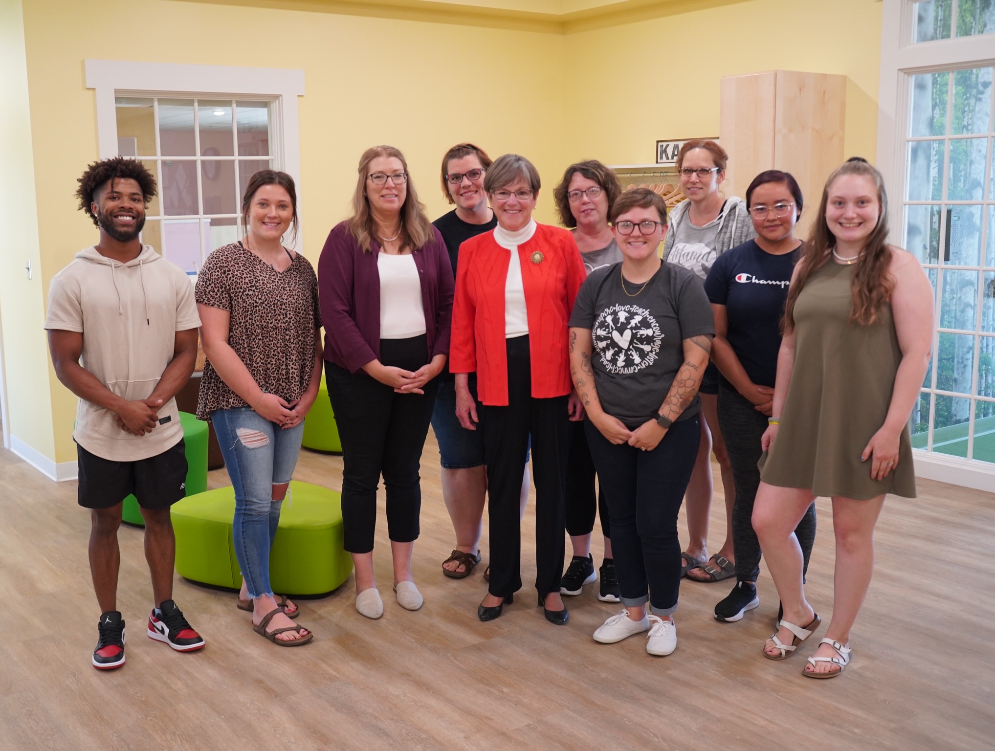
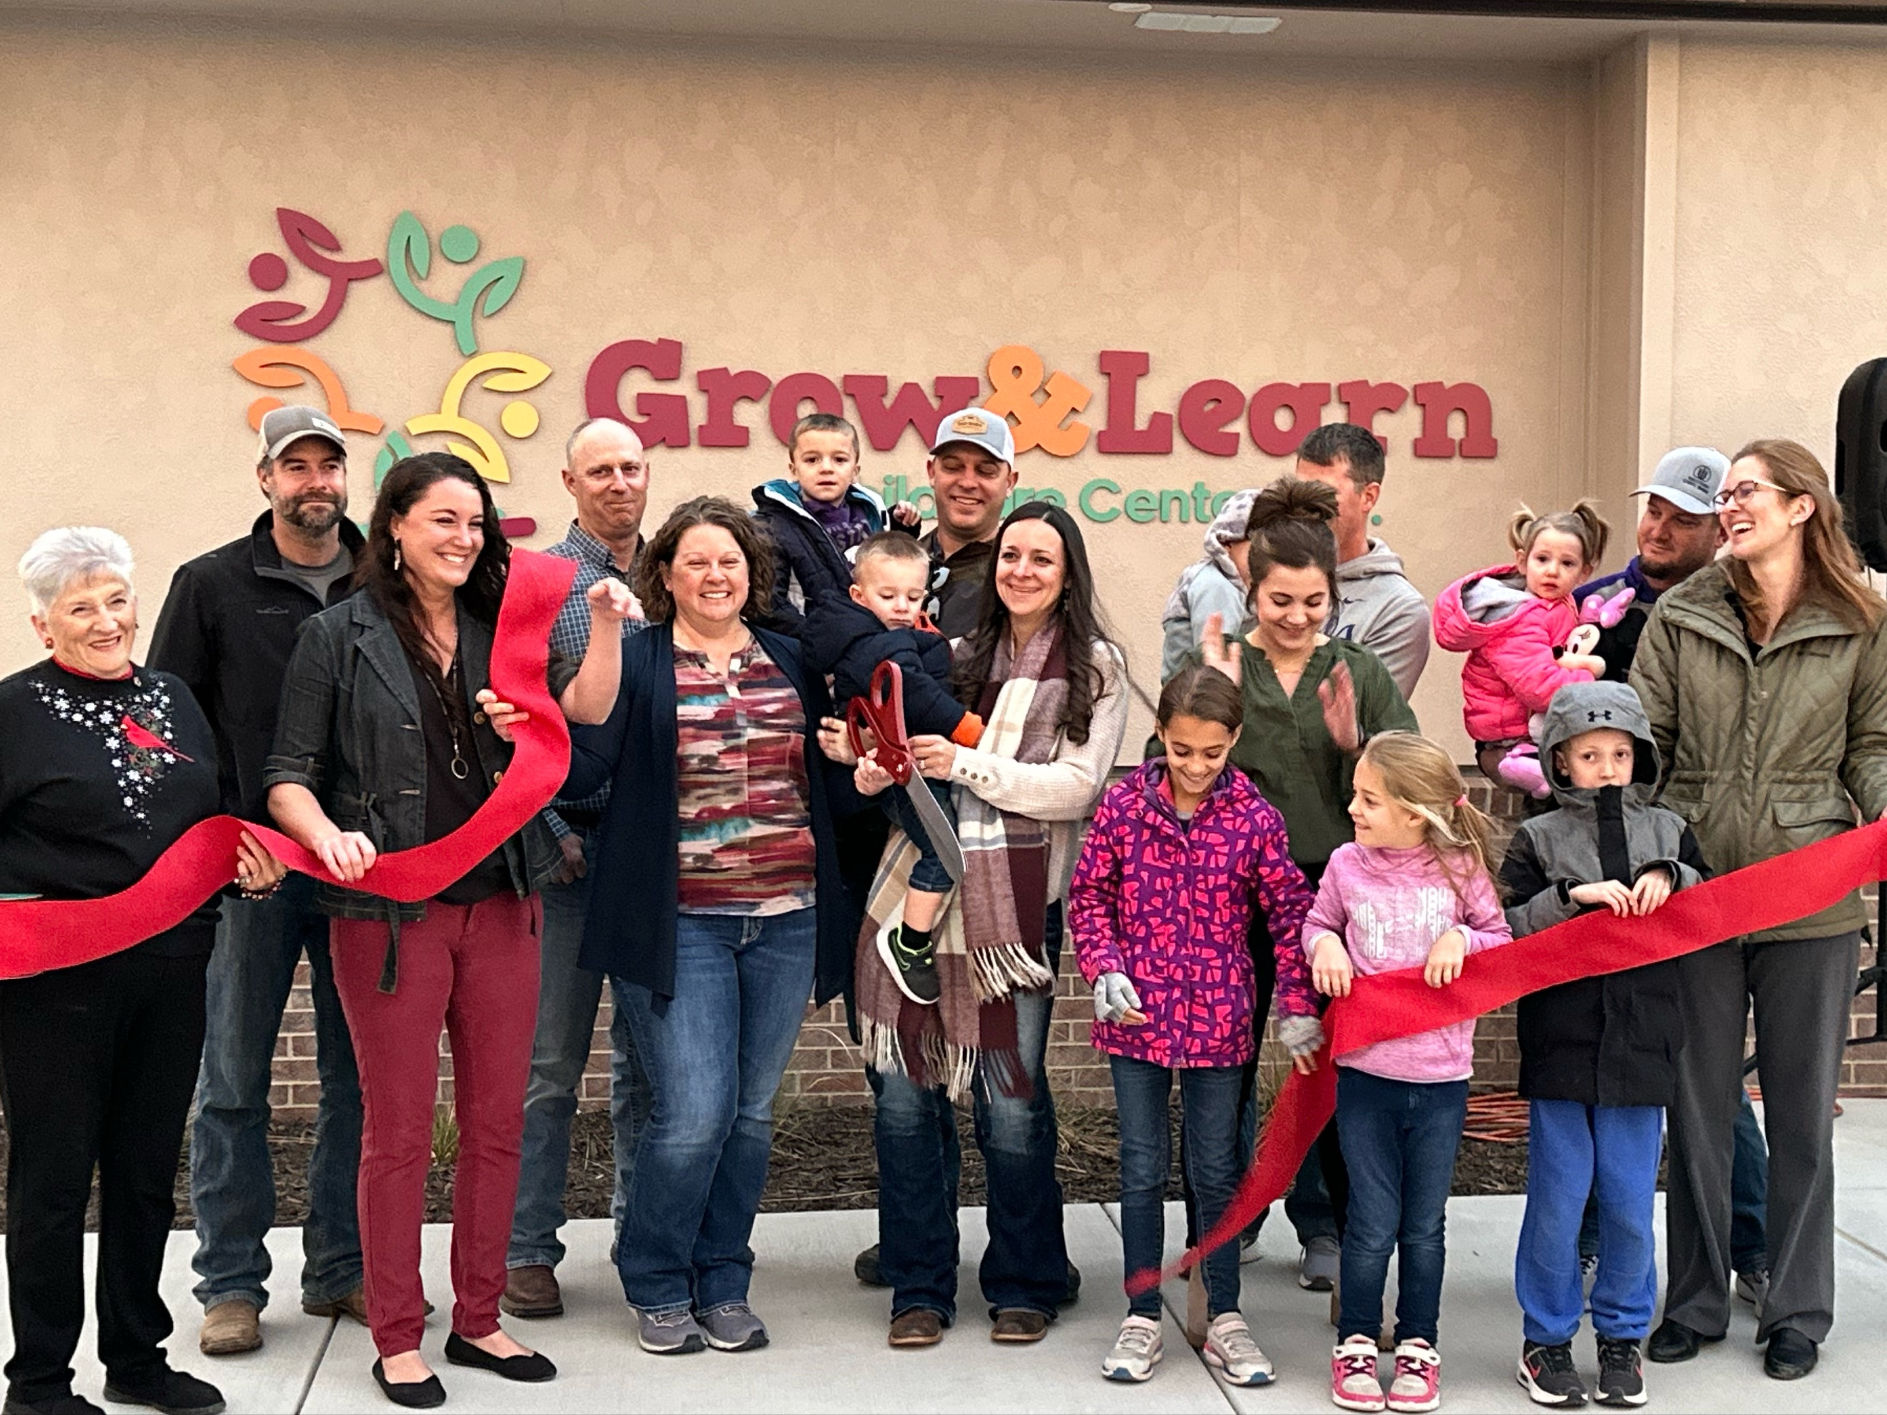
Donations have helped fund…
Non-profit childcare facilities
Sprout House Learning Center, Lindsborg
Grow & Learn Childcare Center Inc., Leoti

Slide 8
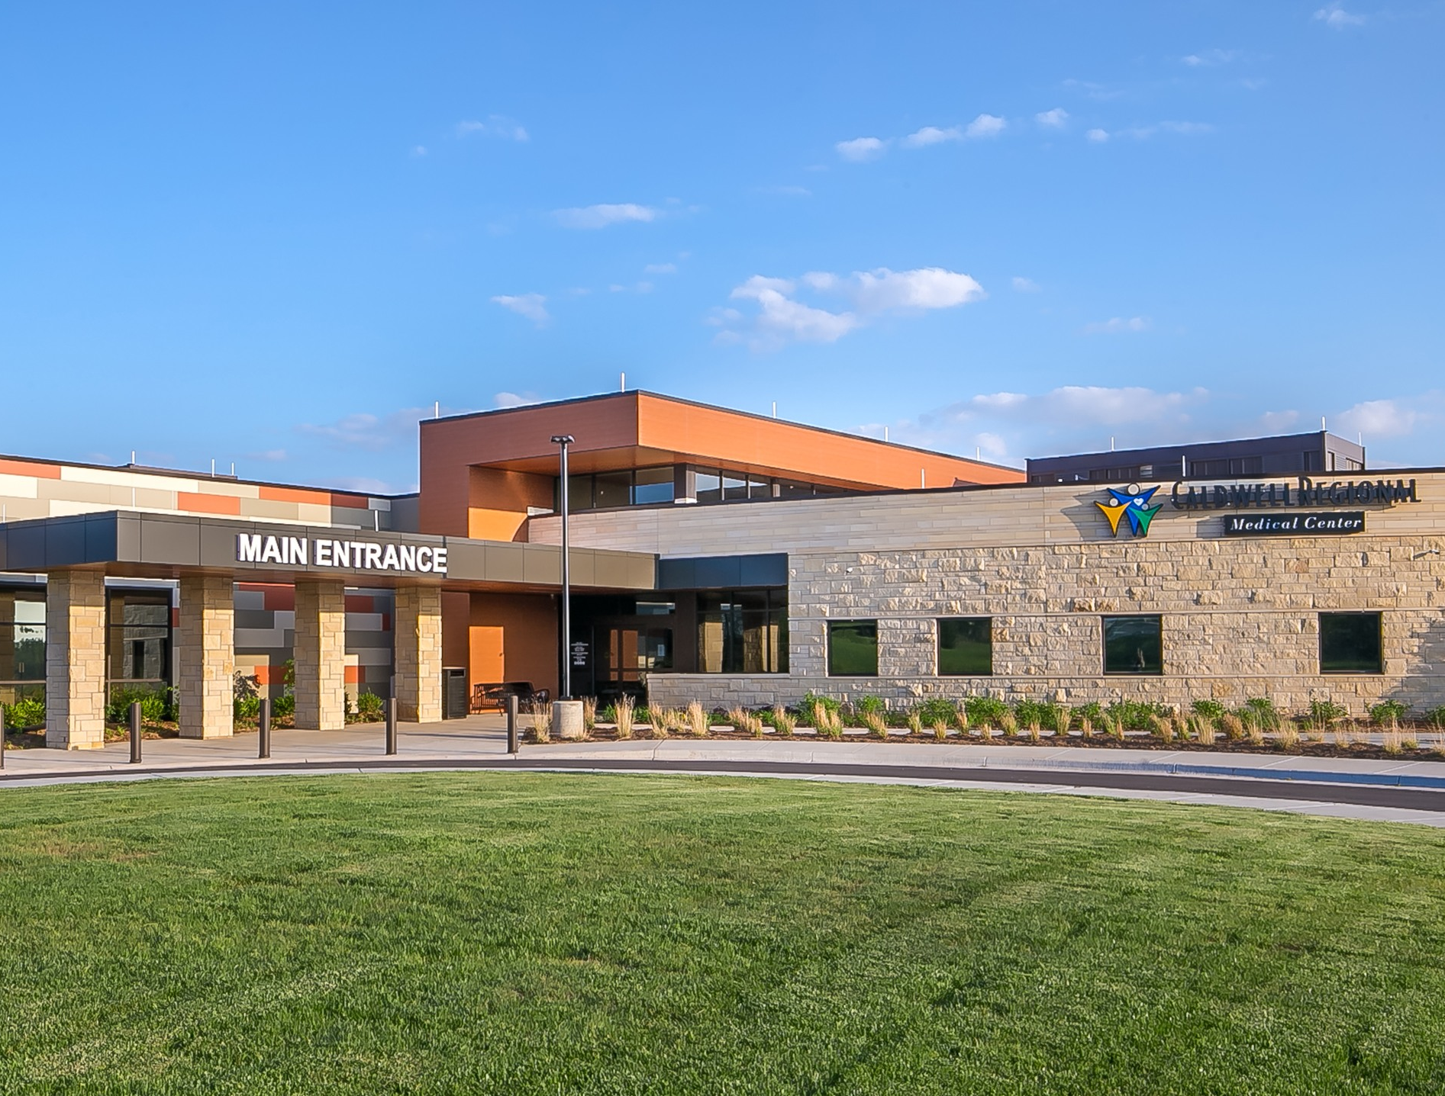
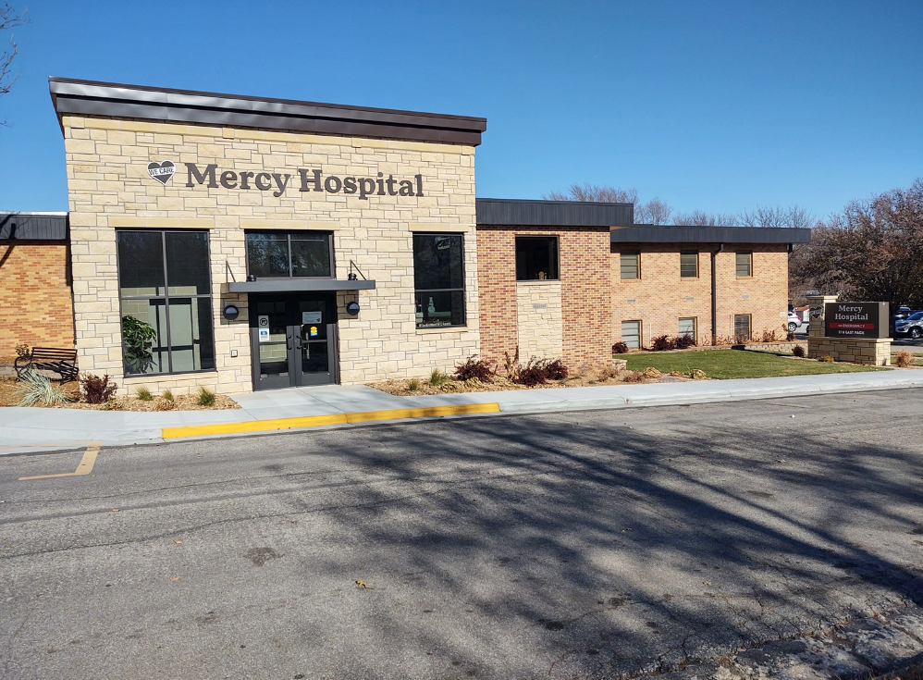
Donations have helped fund…
Health clinics, mental health facilities hospital expansions, renovations, and equipment
Caldwell Regional Medical Center, Caldwell
Mercy Hospital, Moundridge

Slide 9
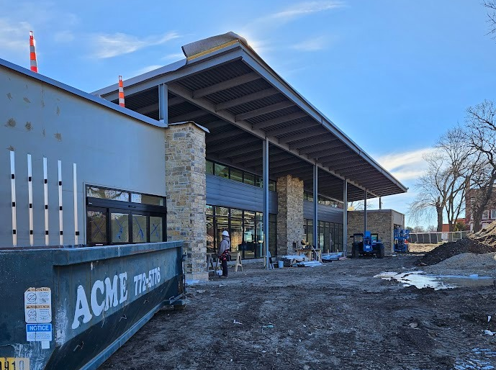
Donations have helped fund…
Arts-focused projects such as centers and theaters
Nursing homes and assisted living facilities
Wellness and fitness projects
Library improvements and much more
Innovation Lab, Emporia Arts Council
Newton Public Library, Newton

Slide 10
Program Timeline
The application opens March 1, 2024 to April 30, 2024
The application will close at 11:59pm
Technical assistance stops at 4:00pm
$250 Non-Refundable Application Fee
Awarded projects will be notified no later than July 1, 2024
Tax Credits will be “active” July 1, 2024 to December 31, 2025
Final Project reports will be due by June 30, 2026

Slide 11
Funding
Available Funds
$4.1 million is available
Maximum Award
$200,000 in tax credits

Slide 12
Who can apply?
Kansas non-profit corporations and foundations
Organizations holding IRS ruling 501(c)3
Organizations incorporated in the state of Kansas or another state as a non-stock, nonprofit organization
Organizations designed as a community development corporation by the United States government
Organizations chartered by the United States Congress
City, county or district hospitals, nursing homes, health departments and medical clinics
NOTE: City and County Governments are NOT eligible to apply.
Eligible organizations may not receive tax credits for two consecutive award years. Previously awarded CSP projects are not eligible to apply, even if award years are not consecutive.

Slide 13
What are Tax Credits?
A direct reduction from the final tax obligation in the awarding jurisdiction (state in this case)
Not the same as a deduction
Better than a deduction
Can be combined with a deduction in some circumstances (State Credit + Federal Deduction)
Refundable: If the tax credit is greater than the tax credit liability, the tax filer receives a refund.
Transferrable: The tax credit can be transferred from a donor to an entity that is subject to KS income tax. The transfer must be for the full amount. (Not refundable after transfer)

Slide 14
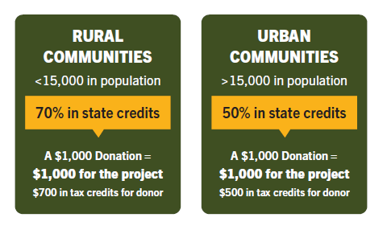
How Do Tax Credits Work?
Through CSP, the state authorizes selected non-profit organizations to offer tax credits to donors for the benefit of approved projects. Applicants may request up to $200,000 in tax credits. Projects should be new or one-time in nature and create lasting value for the
non-profit organization.
Businesses and individuals subject to Kansas income tax are eligible to receive a tax credit through this program. Donations must be $250 or greater and the payment
should come directly from the business or the individual.

Slide 15
CSP Project Budget Example:
Tax Credit Allocation at 70% (rural)
$150,000
Will generate $214,285 in donations
Tax Credit Allocation at 50% (urban)
$150,000
Will generate $300,000 in donations
You’re simply dividing the amount requested or awarded ($150,000) by the percentage associated with your community (.70 or .50)

Slide 16
TAX CREDIT EXAMPLE:
Taxpayer donates $1000 to CSP Project
CSP Project funds increase by $1000
Taxpayer receives either $500 or $700 tax credit
CSP Project tax credit balance reduced by $500 or $700

Slide 17
What Happens After the Award?
Taxpayer donates to CSP Project
Revenue system generates Certificate Letter for taxpayer
CSP Organization sends Certificate Letter to taxpayer
CSP Project Director enters required information and documents into online Revenue system
Commerce approves tax credit via online Revenue system
Taxpayer files K-60 to claim credit

Slide 18
ELIGIBLE CONTRIBUTORS
Businesses subject to Kansas state income tax
LLCs, S-Corp, Sole Proprietorship, etc.
Banks, savings, and trust companies paying and subject to annual tax on net income.
Individuals subject to Kansas state income tax
Even those who live outside of Kansas

Slide 19
ELIGIBLE CONTRIBUTIONS
Must be valued at a minimum of $250:
Cash Donations
Photocopy of check or cash or credit card receipt
Stocks and Bonds
Stock Transfer Form + Confirmation of Transfer
Personal Property Items
Two appraisals if over $1,000
Real Estate Donations
Two appraisals + Used by Project
Payroll Deductions
Project Materials or Labor
Invoice on OFFICIAL business/ organization letterhead

Slide 20
Application Requirements
Narrative Sections:
Organization Introduction: 250 word limit
Project Need: 300 word limit
Project Summary: 300 word limit
Project Administration: 250 word limit
Project Goals and Timeline: 350 word limit
Organization Funding Capacity: 350 word limit
Project Funding Strategy: 350 word limit
Budget Justification: 200 word limit
Project Support: 250 word limit
Pledge Letters and Community Support Letters
Refer to page 9 in the CSP Guidelines for more details.

Slide 21
Application Requirements
Attachments:
Articles of Incorporation
Bylaws of the organization
IRS tax-exempt status
A current “letter of good standing” from the Kansas Secretary of State
A current list of the board of directors
Pledge letters of financial support for the project
Other letters showing support and
Independent Audit, OR Independent Agreed Upon Procedures, OR IRS Form 990 This is NOT an exhaustive list. Refer to page 10 in the CSP Guidelines for more details.

Slide 22
Application Walkthrough

Slide 23
RATING PROCESS
Two Raters per Application
Average Scores Taken
Raters meet to debate and defend scores, determine award sizes, and finalize awards
Determinations are sent to Lt. Governor for final approval

Slide 24
Scoring Rubric
Criteria | Max Points
Project Need/Summary | 45 Points
Innovation | 5 Points
Agency Capacity | 10 Points
Project Planning | 10 Points
Fundraising Capacity | 30 Points
Community Support | 15 Points
Overall Quality | 15 Points
Confidence in Project | 20 Points
TOTAL | 150 Points

Slide 25
Website Walkthrough

Slide 26
Questions?

Slide 27
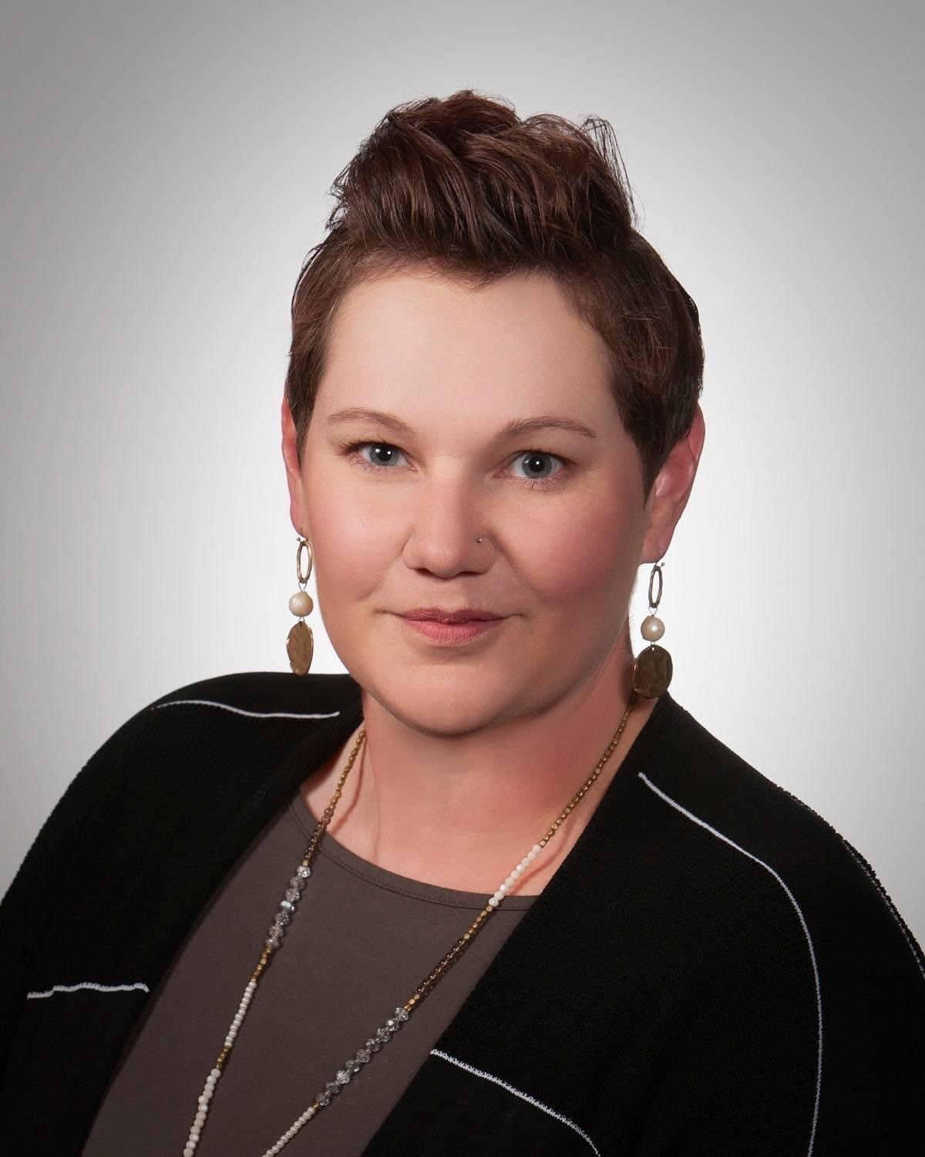
Contact
Sara Bloom
Community Development Specialist
CSP and IDA Program Coordinator
Kansas Department of Commerce
1000 S.W. Jackson Street, Suite 100
Topeka, Kansas 66612-1354
Phone: (785) 506.9278
e-mail: Sara.Bloom@ks.gov

