Slide 1
THIRD THURSDAY: APPLICATION PORTAL
CDBG 2024

Slide 2
MEET THE TEAM
CDBG 2024
ANDREW HAYMAN
ANNE ZAJIC
SANDY VOTAW
CDBG Director
CDBG Assistant Director
Senior Administrative Assistant
GINNY EARDLEY
JESSICA PIERCE
TIM PARKS
Project Specialist
Project Specialist
Project Specialist
JASON TEAL
Project Specialist

Slide 3
NEW CENSUS DATA RELEASED
CDBG 2024
HUD released new low- and moderate-income summary data (LMISD) based on the 2016-2020 American Community Survey (ACS)
As of August 1, 2024, to qualify any new low- and moderate-income area (LMA) activities, Community Development Block Grant (CDBG) grantees should use this new data.
See Notice CPD-24-04: Low- and Moderate-Income Summary Data Updates for more details.

Slide 4
BEFORE WE BEGIN
CDBG 2024
Whether this is your first time in CDBG administration or just want a refresher, new user guides for the application portal have been made available in our Resource Library under “Application Support”:
Salesforce Account Contact Relationship
Salesforce Forgot Password
Salesforce Forgot Username
Salesforce Registration Process – On behalf of Yourself
Salesforce Registration Process – On behalf of a Business
https://www.kansascommerce.gov/program/community-programs/cdbg/resource-library/

Slide 5
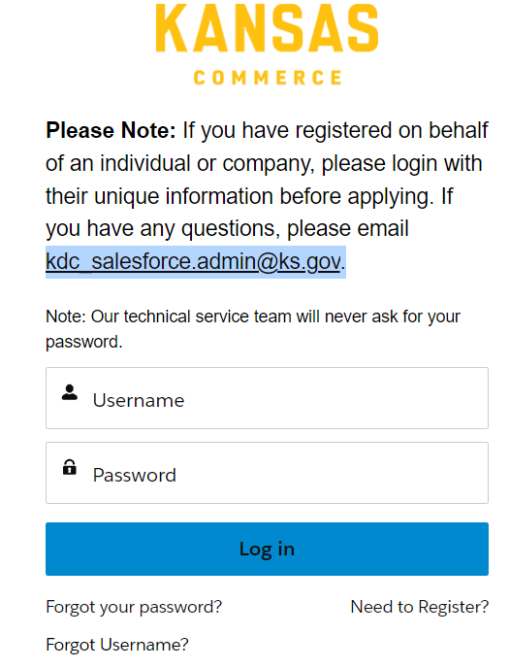
ACCESSING THE PORTAL
CDBG 2024
https://kansascommerce.my.site.com/Grants/s/login/
The application portal can also be accessed through each corresponding CDBG program page on the Department of Commerce website.
If you already have an account, you do not need to register again: log in to the portal using your existing credentials. However, if you need to register for a new account, just click “Need to Register?” found underneath the login fields.

Slide 6
CREATING AN ACCOUNT
CDBG 2024
Administrators should create a business account on the portal. This will allow applications for multiple applicant cities or counties once an account relationship has been established.
If you have issues creating your account, contact Commerce IT at kdc_salesforce.admin@ks.gov.
There is a step-by-step guide on how to create an account on the CDBG website under “Application Support”: https://www.kansascommerce.gov/program/community-programs/cdbg/resource-library/.

Slide 7
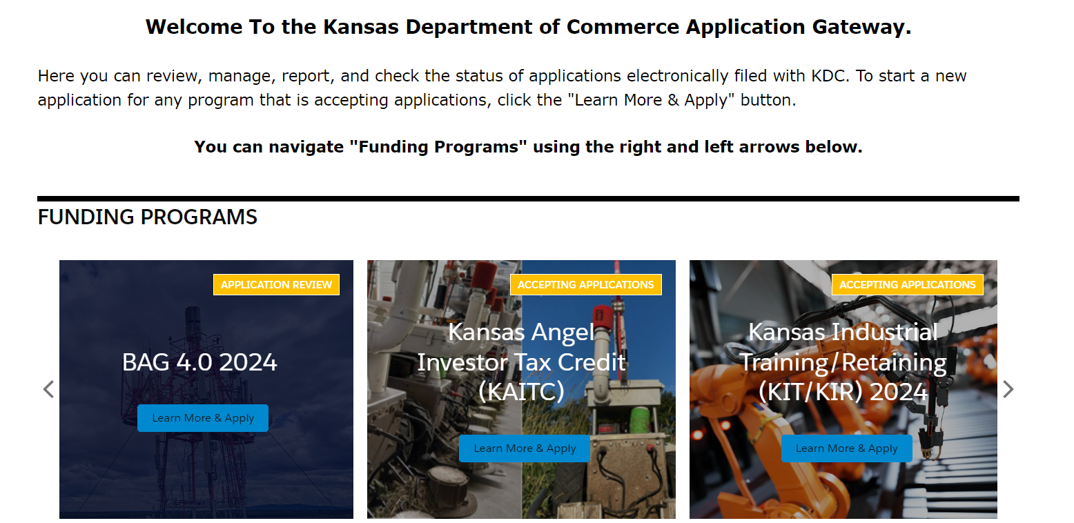
APPLICATION PORTAL
CDBG 2024
Once logged in, the applicant city or county is taken to the “Application Gateway”:

Slide 8
APPLICATION PORTAL
CDBG 2024
The CDBG application is at the bottom of the page. Click on this icon outlined in red below to be taken to the next step.

Slide 9
APPLICATION PORTAL
CDBG 2024
To work on a previously saved and drafted application, click “Continue CDBG Application.”
To create a new application, click “Create NEW CDBG Application.”
If any sort of error occurs or issues arise, contact kdc_salesforce.admin@ks.gov.

Slide 10
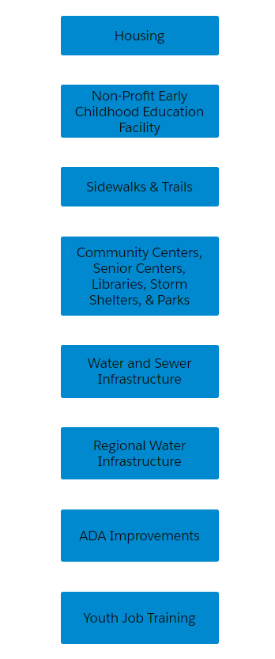
APPLICATION PORTAL
CDBG 2024
The “CDBG Application Categories” will all be listed on the page to which the applicant city or county is taken.
To create a new application, click on the appropriate application category.

Slide 11
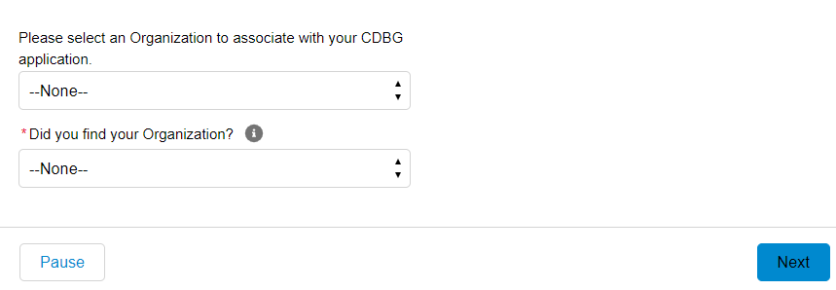
APPLICATION PORTAL
CDBG 2024
Once the application category is selected, a screen will open as a new window.
It will list the two options below.

Slide 12
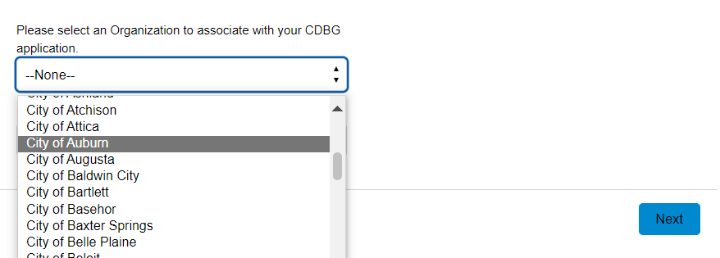
APPLICATION PORTAL
CDBG 2024
Select which city or county the application is for.

Slide 13
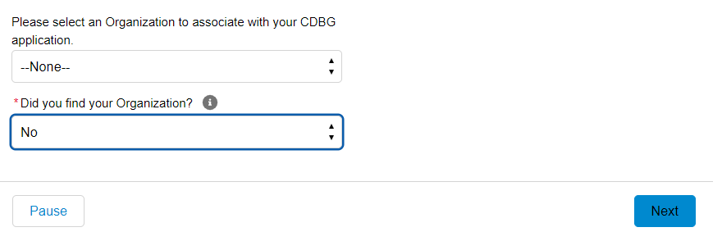
APPLICATION PORTAL
CDBG 2024
If the applicant city or county is NOT available, then select “None” in the first question field and “No” on the second question field. Then click “Next”! A new screen will appear where you can create your entity.
All eligible CDBG entities should already be in the database and applicants should not need to follow this step.

Slide 14
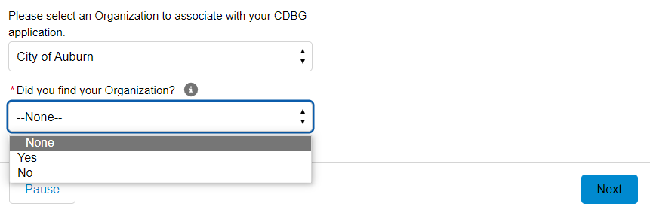
APPLICATION PORTAL
CDBG 2024
If the applicant city or county is available, then select “Yes” for the second question field and click “Next.”

Slide 15
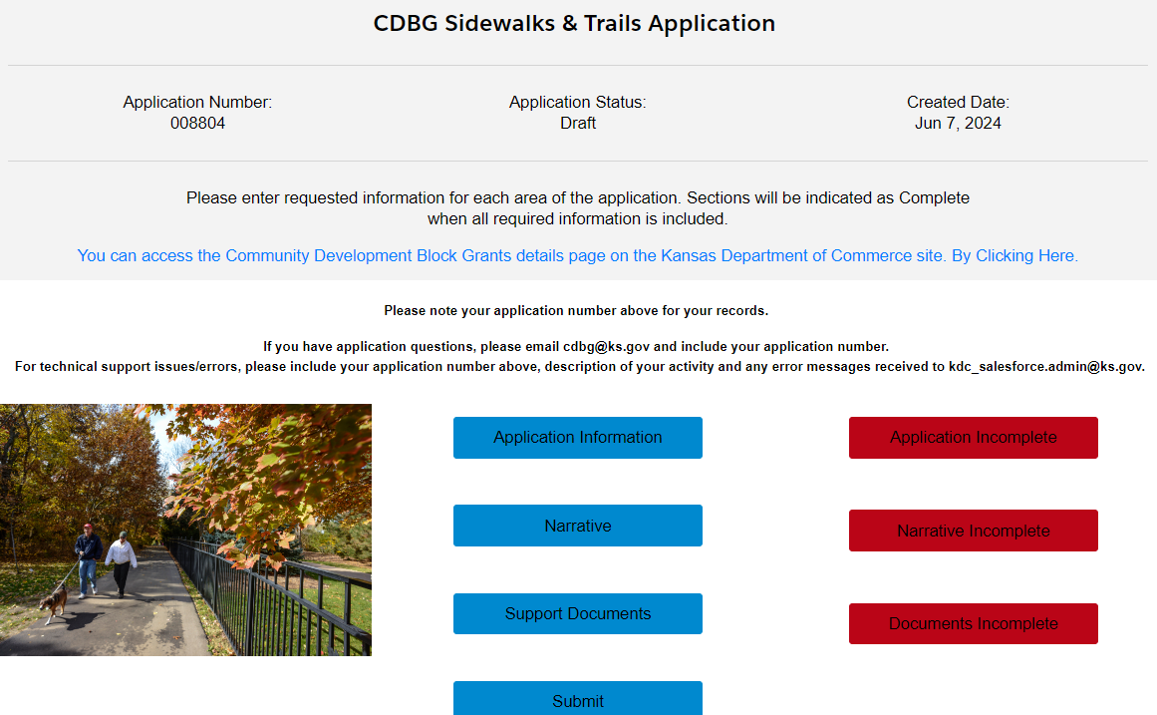
APPLICATION PORTAL
CDBG 2024
For this example, the Sidewalks & Trails application is being used as a demonstration.
The next step is to click on “Application Information,” which will open a new screen.

Slide 16
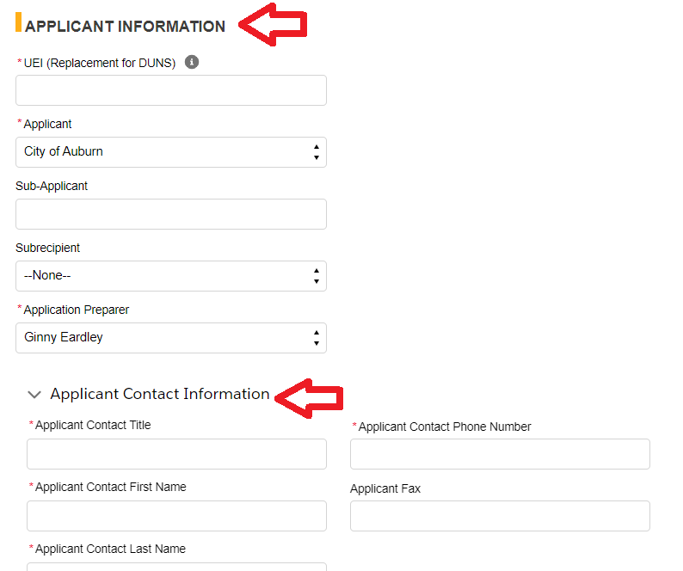
APPLICATION INFORMATION
CDBG 2024
This is the applicant city or county’s information, NOT the grant administrator or grant writer’s information!
If the application is on behalf of another nongovernmental entity, that entity will be entered under “Sub-Applicant”.
If they are a governmental entity, that will be found in the subrecipient menu.

Slide 17
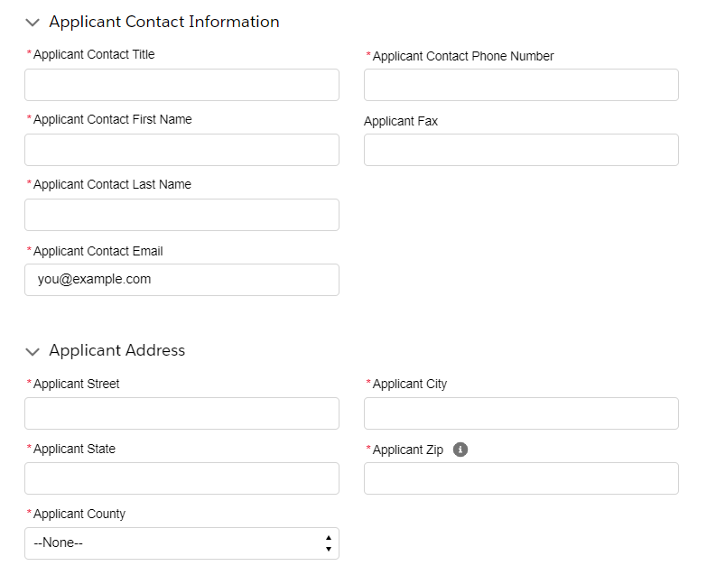
APPLICATION INFORMATION
CDBG 2024
This is a continuation of the application’s information that we need to gather for the application!

Slide 18
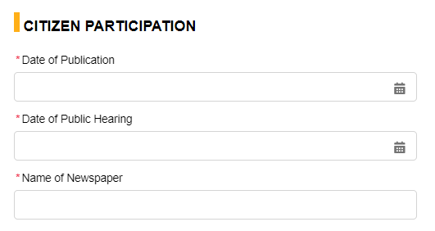
CITIZEN PARTICIPATION
CDBG 2024
Enter information here regarding the first required public hearing for the project.
No fewer than 7 days nor more than 20 days between Date of Publication and Date of Public Hearing.

Slide 19
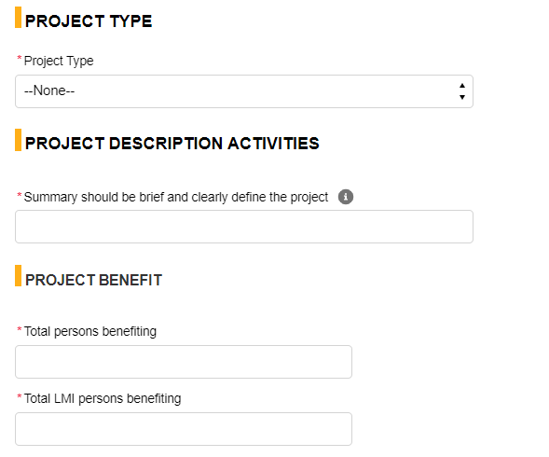
PROJECT INFORMATION
CDBG 2024
This is where the project type is selected as well as a brief sentence describing the project.
Please enter the number of total beneficiaries and total LMI beneficiaries.

Slide 20
LMI
CDBG 2024
This is where the project LMI determination is selected. If survey is selected, enter the date the survey began.
Multiple methods can be selected depending upon the type of project.
“Limited Clientele” option will be added for YJT, ADA, and Childcare applications.

Slide 21
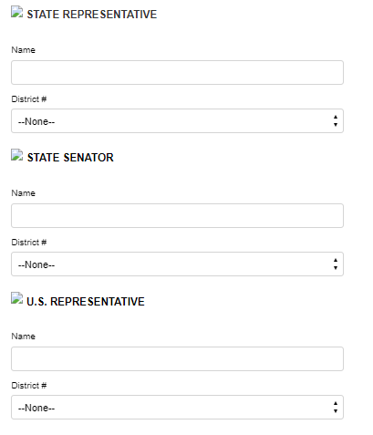
REPRESENTATIVES AND SENATOR
CDBG 2024
Enter the names and district for each of the representatives and senator for your area.

Slide 22
PERFORMANCE CAPACITY
CDBG 2024
Each CDBG project must have an administrator assigned to manage the project.
Administrators can be current city/county staff (not paid for by CDBG funds, but can be used as matching funds, tracking hours of work and pay), consulting services such as a Regional Planning Commission or Grant Administrator Service, or a new Hired Staff member for the applicant.
Make the correct selection and click “Next.”

Slide 23
SAVING APPLICATION INFORMATION
CDBG 2024
After all required data has been filled out and confirmed for accuracy in the “Application Information” section, select “Next.” Clicking this will save the progress of your application.
Do NOT select “Close” as it will NOT save the application information data entered.

Slide 24
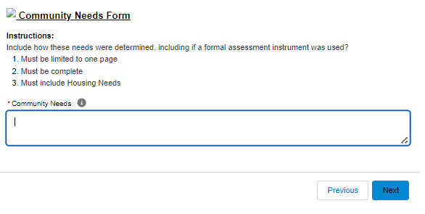
COMMUNITY NEEDS FORM
CDBG 2024
The “Community Needs Form” is required for all applications! This is a brief and precise narrative describing the community’s needs as a whole.
This is NOT where the applicant will discuss the project need; housing needs MUST be discussed. Draft this narrative in a word processing program before beginning the application for easy copy and paste.
Select “Next” to move forward in the application or “Previous” to return to the “Application Information” section.

Slide 25
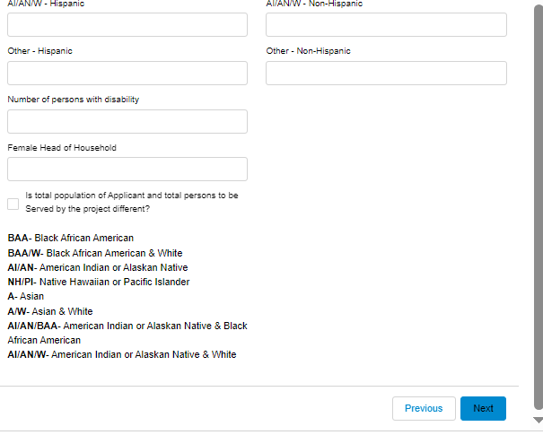
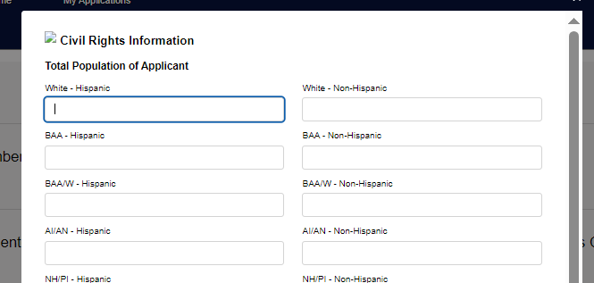
CIVIL RIGHTS INFORMATION
CDBG 2024
This section is to collect known demographic information of the applicant city or county.
Once it is completed select “Next.”

Slide 26
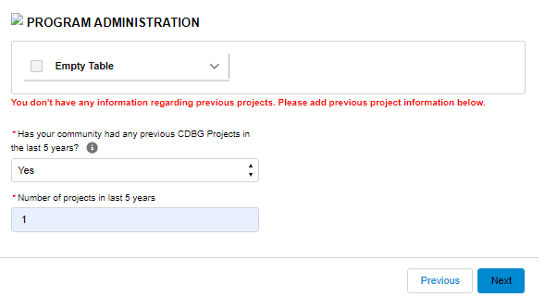
PROGRAM ADMINISTRATION
CDBG 2024
This section allows the applicant to notify us of any CDBG projects from the past five years.
We ask for this information to have a picture of what projects have already been done in the community, and to evaluate if this is a new community which hasn’t utilized the program before.
If “Yes” is selected, enter the number of projects and click “Next.”

Slide 27
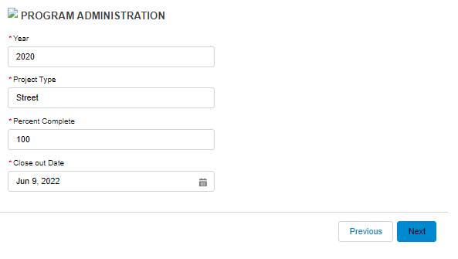
PROGRAM ADMINISTRATION
CDBG 2024
A new screen will appear where information about the previous project(s) can be entered.
If more than one project needs entered, after clicking “Next,” a prompt to enter the data for the second project will appear.
After all projects have been entered, click “Next” to move forward in the application.

Slide 28
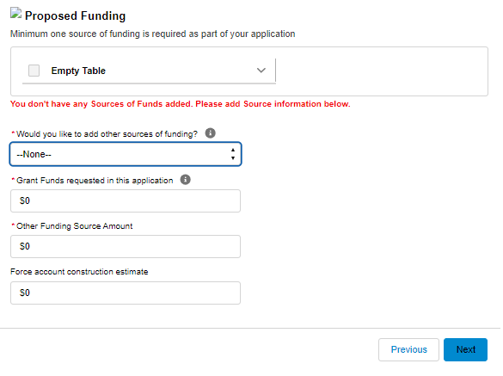
PROPOSED FUNDING
CDBG 2024
Matching funds are a requirement for most CDBG programs and can be confirmed in the “Proposed Funding” section of the application.
Applicant city or county will select “Yes” on the first question field, for all applications. Selecting this will populate a box to enter the number of additional funding sources.
Enter the grant funds requested and the other funding source amount in whole dollars only!

Slide 29
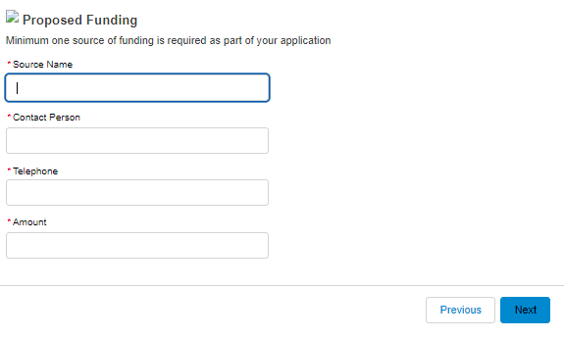
PROPOSED FUNDING
CDBG 2024
After selecting “Next” on the previous screen, a new screen will appear to enter the “Source Name,” “Contact Person,” “Telephone,” and “Funding Amount.”
If more than one source is entered, after clicking “Next,” a prompt to enter the data for the additional sources will appear.
Click “Next” to save the data and move to the subsequent section of the application.

Slide 30
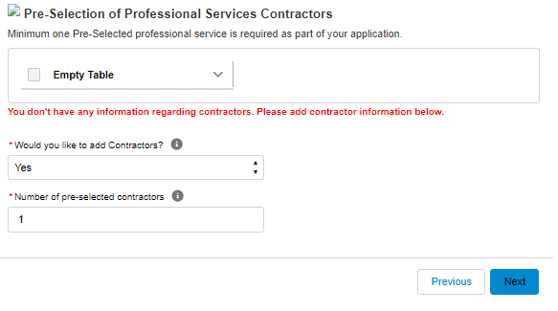
PRE-SELECTION OF PROFESSIONALS
CDBG 2024
This section will include information regarding any pre-selected professionals. This includes grant administrators, engineers, and architects.
All programs most likely will have at least one professional service that must be entered.
After selecting “Yes,” click “Next” to save and go to the next section of the application to enter the professional’s information.

Slide 31
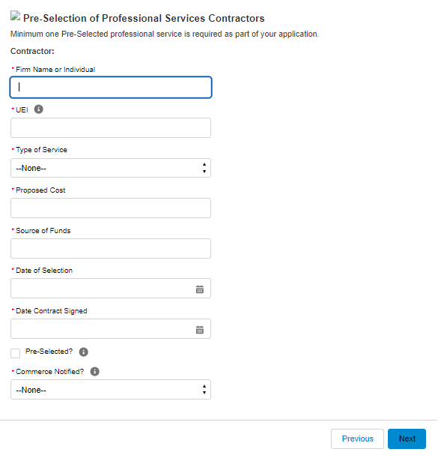
PRE-SELECTION OF PROFESSIONALS
CDBG 2024
Enter the pre-selected professional's data in the appropriate boxes. Every pre-selected professional MUST have a UEI number.
After the data is entered select “Next.”
If more than one professional was entered, after clicking “Next,” a prompt to enter the data for the additional professionals will appear.

Slide 32
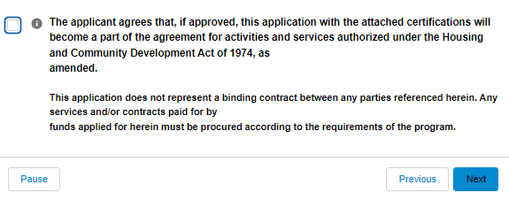
COMPLETING THE APPLICATION
CDBG 2024
Upon completion of all the application information, the applicant city or county will select the box on the left confirming they agree to all the regulations and restrictions that govern the federal CDBG program.
Next step is to click “Next” to save.

Slide 33
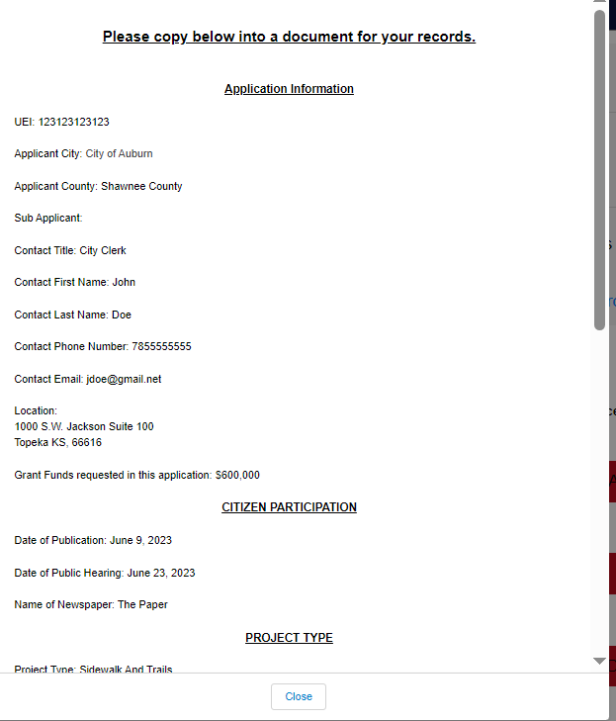
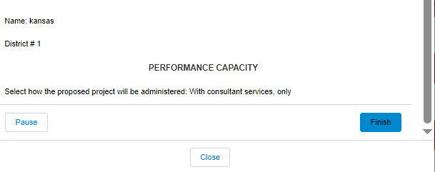
COMPLETING THE APPLICATION
CDBG 2024
To save a copy of the data that has been entered, you can copy and paste the data into a word processer file.
Click “Finish” to submit the Application Information section. Do NOT click close, as it will not save the entered information.

Slide 34
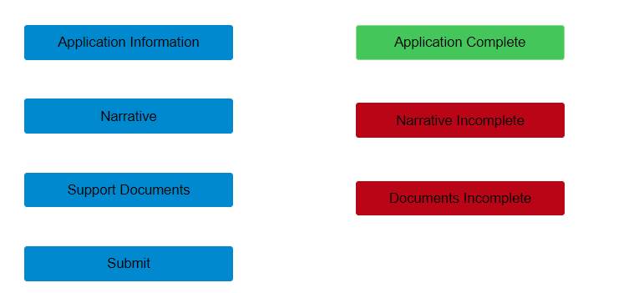
CDBG 2024
COMPLETING THE APPLICATION
The applicant city or county will be taken back to the application’s landing page.
The Application Information tab should now have a green box next to it saying, “Application Complete.”
This indicates that section of the application has been finished, and editing is still allowed until final submission.
Note: if the box does not turn green immediately, refresh the screen!

Slide 35
COMPLETING THE NARRATIVE
CDBG 2024
The applicant city or county will click Narrative to open the Narrative section of the application.
Narrative Questions are available ahead of application submission in each program’s Application Guidelines on the CDBG website: https://www.kansascommerce.gov/cdbg/
The answers to these questions should be drafted before application and pasted into the answer boxes.
The Narrative section does NOT have a print option, which is also why these narratives should be drafted prior to working on the application.

Slide 36
COMPLETING THE NARRATIVE
CDBG 2024
Make sure that the correct answers are copied in the correct boxes.
Keep the answers to the questions as detailed and short as possible. We want to know the need and story behind the project; however, it should be condensed.

Slide 37
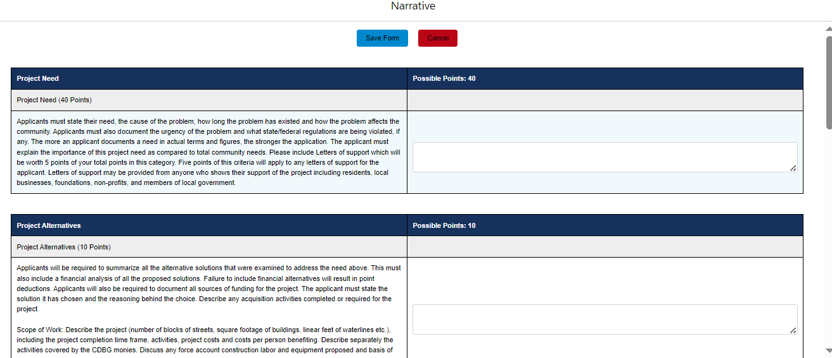
COMPLETING THE NARRATIVE
CDBG 2024

Slide 38
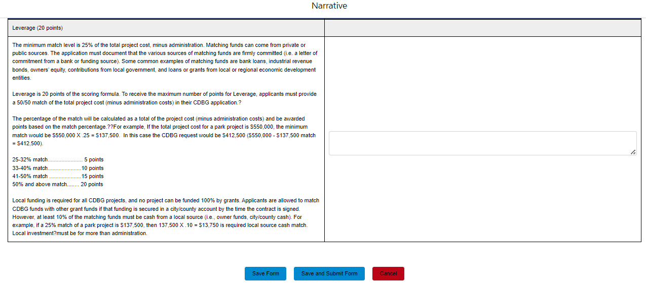
COMPLETING THE NARRATIVE
CDBG 2024
Note: after completion, click the “Save and Submit Form” button. Do NOT click cancel, as it will not save any data.

Slide 39
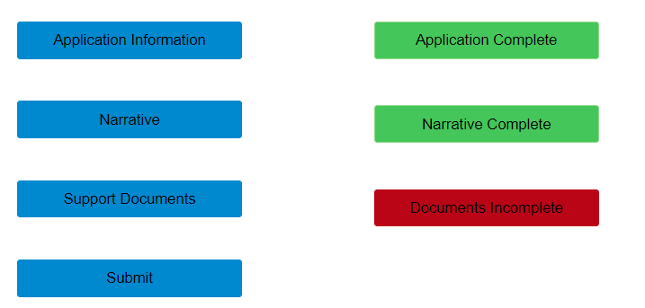
COMPLETING THE NARRATIVE
CDBG 2024
After clicking “Save and Submit Form,” the applicant city or county will be taken back to the application’s landing page.
The narrative should now have a green box next to it saying, “Narrative Complete.”
This indicates that section of the application has been finished, editing is still allowed until final submission.
Note: if the box does not turn green immediately, refresh the screen!

Slide 40
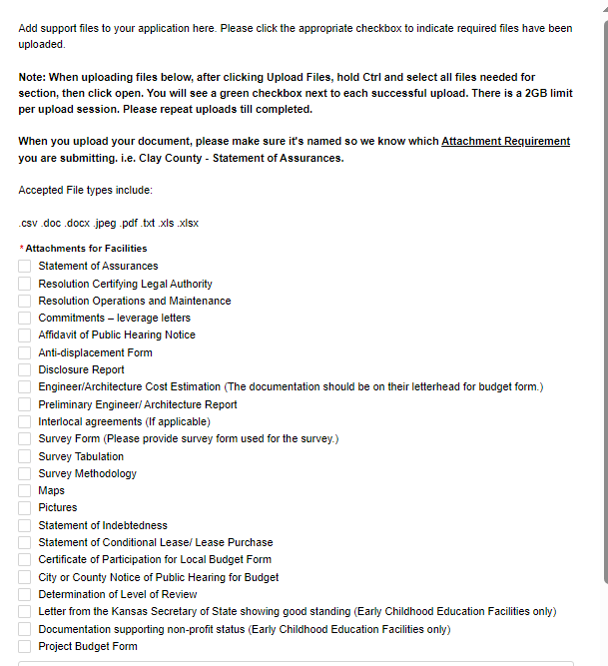
SUPPORT FILES
CDBG 2024
Note: Read the captions next to each file to know if the project application requires a particular document!
Support files are important additional documentation for all applications. This example is for a community facilities project.
The support files list should have all the required documentation for the application.

Slide 41
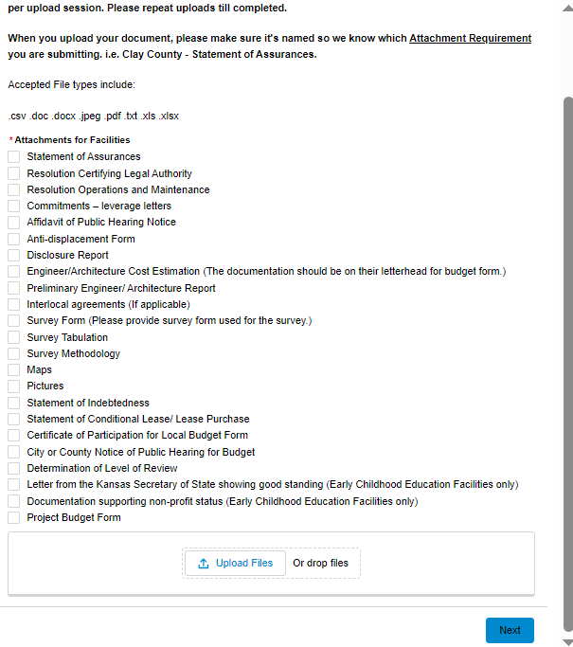
SUPPORT FILES
CDBG 2024
Select each applicable checkbox to indicate which support files are being uploaded. The attachments will appear at the bottom of the screen so you can keep track of what has been uploaded.
When you upload your document, please make sure it's named so we know which attachment requirement you are submitting, i.e., “Clay County - Statement of Assurances.”
Use the “Upload Files” button or drag and drop files to upload each attachment. Repeat as necessary.
Once the upload has completed, click “Next”!

Slide 42
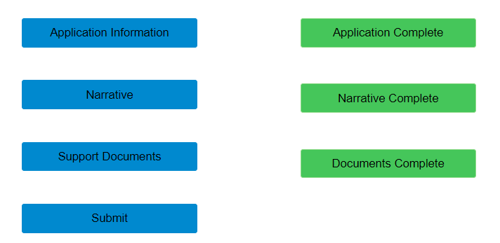
SUPPORT FILES
CDBG 2024
The applicant city or county will be taken back to the application’s landing page.
The documents tab should now have a green box next to it saying, “Documents Complete.”
This indicates that section of the application has been finished, but editing is still allowed until final submission.
Note: if the box does not turn green immediately, refresh the screen!

Slide 43
FINAL SUBMISSION
CDBG 2024
The applicant city or county should verify that the whole application is complete and ready for submission.
Click Submit when the application is finalized. A message stating the application has been successfully submitted will appear. Click Next
A final confirmation message will appear. Editing is NOT available at this point!

Slide 44
CDBG 2024
FINAL THOUGHTS
Printing options for the full application are not available at this time. It is very important to keep copies of drafted narratives!
If there are corrections that need to be made after submission, please contact the CDBG team. The CDBG team will contact the applicant city or county for corrections that do NOT cause a Threshold as needed.
Should an application not pass Threshold, the applicant city or county will not be notified until award announcements are made.

Slide 45
THANK YOU!
QUESTIONS?
Ginny Eardley
CDBG Project Specialist
Ginny.M.Eardley@ks.gov

