Slide 1

Kansas Housing Development
May 1, 2026

Slide 2

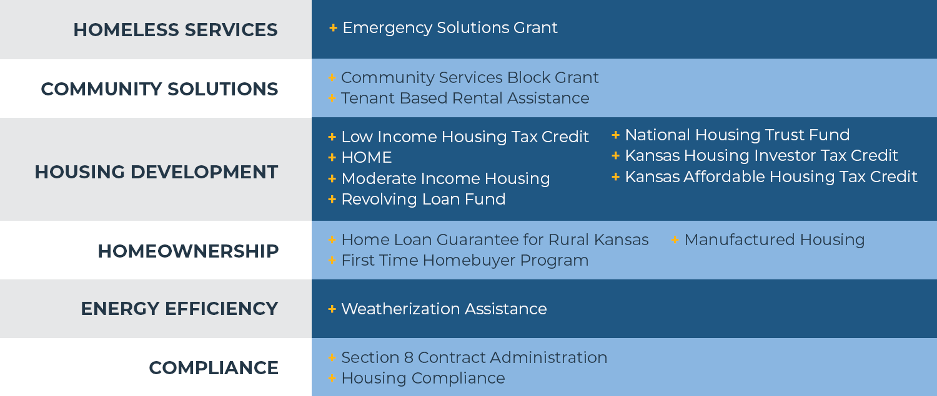
OUR PROGRAMS

Slide 3
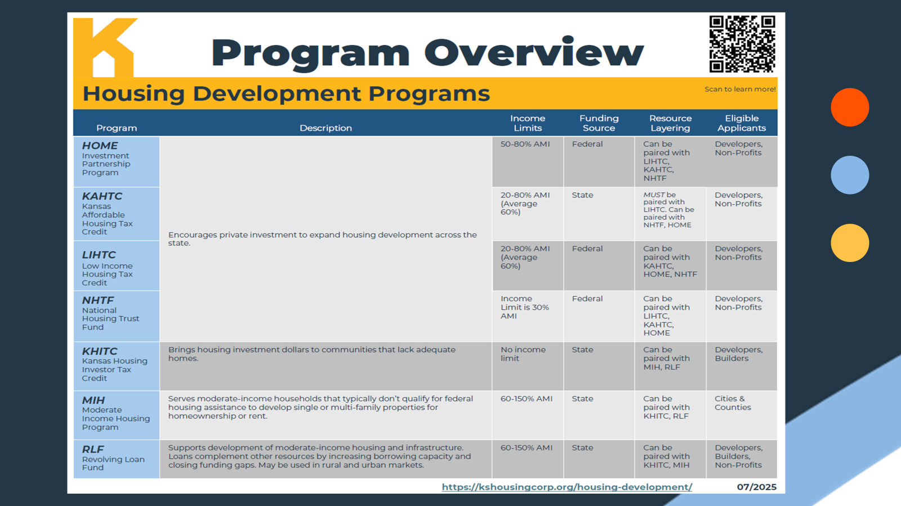

Slide 4
What is LIHTC?
The Low-Income Housing Tax Credit (LIHTC) program is the most important resource for creating affordable housing in the United States today. Created by the Tax Reform Act of 1986, the LIHTC program gives State and local LIHTC-allocating agencies the equivalent of approximately $10.5 billion in annual budget authority to issue tax credits for the acquisition, rehabilitation, or new construction of rental housing targeted to lower-income households.*HUD.gov
Kansas: Kansas Housing Resources Corporation
The LIHTC gives investors a dollar-for-dollar reduction in their federal tax liability in exchange for providing financing to develop affordable rental housing. Investors’ equity contribution subsidizes low-income housing development, thus allowing some units to rent at below-market rates. In return, investors receive tax credits paid in annual allotments, generally over 10 years.*Novogradac.com
Financed projects must meet eligibility requirements for at least 30 years after project completion. In other words, owners must keep the units rent restricted and available to low-income tenants. At the end of the period, the properties remain under the control of the owner.*Novogradac.com

Slide 5
4% and 9%
4% tax credit = ~30% Subsidy
9% tax credit = ~70% Subsidy*
For 10 years, either a 4% or 9% tax credit can be claimed. The percentages are roughly equivalent to 4% or 9% of the project’s construction cost.
HUD Resources (9% Projects):
HOME Investment Partnership Program (HOME)
National Housing Trust Fund (NHTF)

Slide 6
Income & Rents
The AMI requirements below apply to both the maximum housing expense (affordable to) and household income at move-in (occupied by).
• the average income at least 40% of the units are both rent restricted and are occupied by tenants whose income is less than or equal the unit’s designation and that units are designated in increments of 10% (from 20% to 80%) in a manner that the average of the unit’s designation does not exceed 54% Metro / 57% Rural.
• the 20/50 or 40/60 election and at least 30% of LIHTC units to households at 40% Metro / 50% Rural AMI or below.
Notes:
At least 20 percent of the project’s units are occupied by tenants with an income of 50 percent or less of area median income adjusted for family size (AMI).
At least 40 percent of the units are occupied by tenants with an income of 60 percent or less of AMI.
At least 40 percent of the units are occupied by tenants with income averaging no more than 60 percent of AMI, and no units are occupied by tenants with income greater than 80 percent of AMI.

Slide 7
KAHTC
Kansas Affordable Housing Tax Credit
Kansas Affordable Housing Tax Credit
2,200 Homes Funded in 2023
2,600 Homes Funded in 2024
1,663 Homes Funded in 2025
Leveraging Private Activity Bonds
2022: one $5m development
2023: 12 developments totaling $250m
2024: 14 developments totaling $300m
2025: 8 developments totaling $101m
Notes:
Deanne
Developers are leveraging both state credits and federal Low Income Housing Tax Credits, Private Activity Bonds and HUD resources to maximize impact.
In 2023, the program funded the development of approximately 2,200 homes through KAHTC, Low Income Housing Tax Credits and other federal resources
In 2024, support increased, leading to 2,600 homes funded, demonstrating a growing capacity to invest in affordable housing initiatives across Kansas.
For 2025, KAHTC has already supported 585 homes as of the most recent awards. These units resulted from the first application round of 4% LIHTC and KAHTC funding, which approved four projects expected to deliver 585 new affordable units. This number will increase as more awards are announced this year.
Specifically, to private activity bonds,
In 2022, the program began modestly with just one development totaling $5 million
By 2023, it grew substantially with the addition of the state credit to 12 developments and $250 million in total project costs
In 2024, the momentum continued, with 14 developments totaling $300 million These projects span both urban and rural communities and often pair PABs with 4% Low-Income Housing Tax Credits to deepen affordability.
So far in 2025, through the first round of funding, Kansas has already seen 4 developments utilizing $137 million in bonds.

Slide 8
Capital Stack
Financing 4% and 9% LIHTC Projects
Examples Only

Slide 9
Qualified Allocation Plan
The QAP governs how Low Income Housing Tax Credits (LIHTCs) are awarded across the state and is reviewed and revised on an annual basis.
2027 Qualified Allocation Plan (QAP)
June 2026 | Final internal editing
July 2026 | Final draft QAP with overview of proposed changes; Release draft
August 2026 | Public hearing and comments
September 2026 | Final draft
October 2026 | Complete 2027 QAP
2026 Qualified Allocation Plan (QAP)
4% Projects | Open Applications
9% Projects
January 16, 2026 | Prelim Applications Due
February 27, 2026 | Invitations to Submit Full Apps
May 15, 2026 | Full Applications Due
July 31, 2026 | Award Announcements

Slide 10






Connect with us!
Contact KHRC: info@kshousingcorp.org
Contact LIHTC: HousingDevelopment@kshousingcorp.org
Contact MIH & KHITC: MIH@kshousingcorp.org
Contact RLF: RLF@kshousingcorp.org
Follow our website for updates: kshousingcorp.org
Join our mailing list: kshousingcorp.org/subscribe
Deanne Engstrom
Director of Housing Development
(785) 217-2048
dengstrom@kshousingcorp.org
@KansasHousing
@kansashousingresourcescorp
@Kansas_Housing
Kansas Housing Resources Corporation

